Slide 1
Spatio-social separation and
linguistic complexity in Daghestan
Anastasia Panova & Michael Daniel
Workshop “Spatial and social separation of speech communities and language change”, SLE 2022

Slide 2
Introduction

Slide 3
Problem
It has been suggested that linguistic separation of speech communities may have impact on the complexity of their languages (Trudgill 2011, Nichols 2013).
However, investigating the supposed correlation is hindered by methodological issues.
Previous studies (Baechler 2017) present metrics dependent both on the type and the granularity of landscape data available and the reliability and detail of the linguistic description.
The degree of complexity is also influenced by inheritance — a more complex proto-language develops into more complex daughter languages, independently of social or geographical factors.

Slide 4
Solution
Ways to overcome the issues are, respectively,
(i) using non-relativized values as a proxy for the degree of isolation, such as elevation above the sea level (rather than e.g. degree of accessibility)
(ii) using metrics based on corpora or dictionaries rather than on grammatical descriptions, such as token counts (rather than e.g. structural complexity)
and (iii) comparing genealogically related languages to control for genealogical signal.

Slide 5
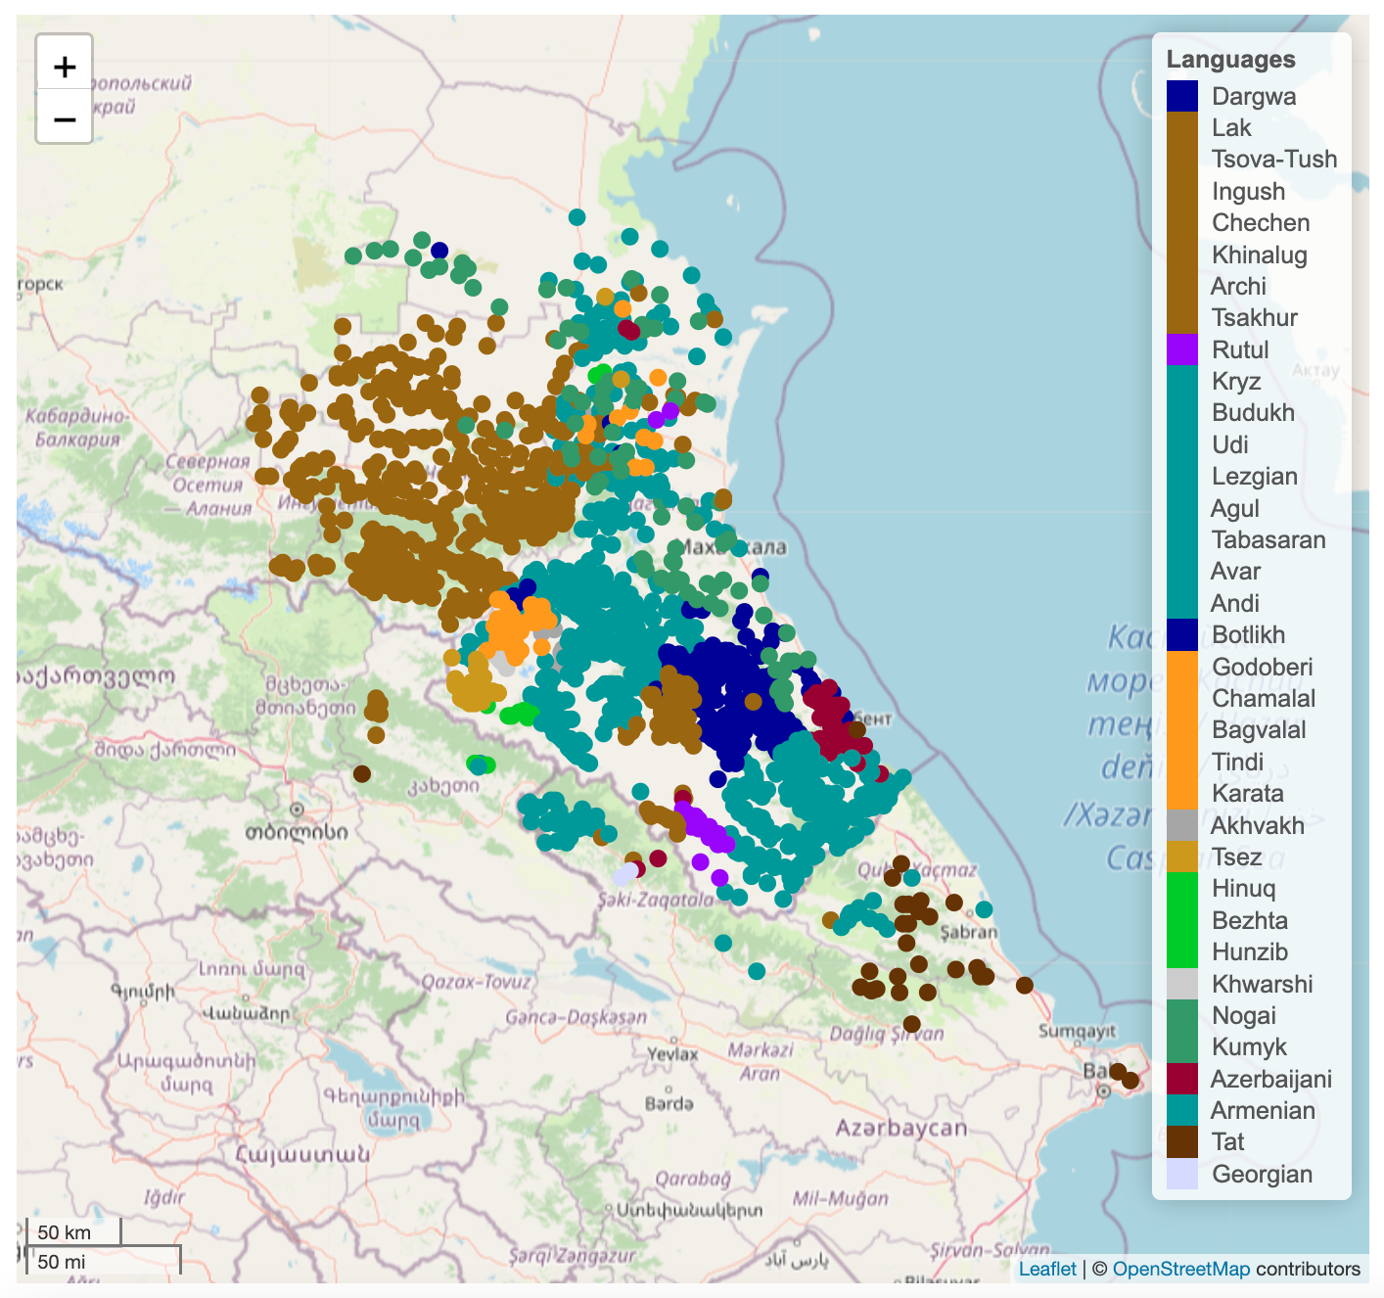
Languages spoken in Daghestan
~ 30 East Caucasian (Nakh-Daghestanian) languages
Branches: Nakh, Avar(-)Andic and Tsezic, Dargwa, Lak, Lezgic and Khinalug
3 Turkic languages
Nogai, Kumyk (Kipchak) and Azerbaijani
1 Iranian language
Tat (other IE languages are late comers)
Source: https://sverhees.github.io/master_villages/maps_new.html

Slide 6
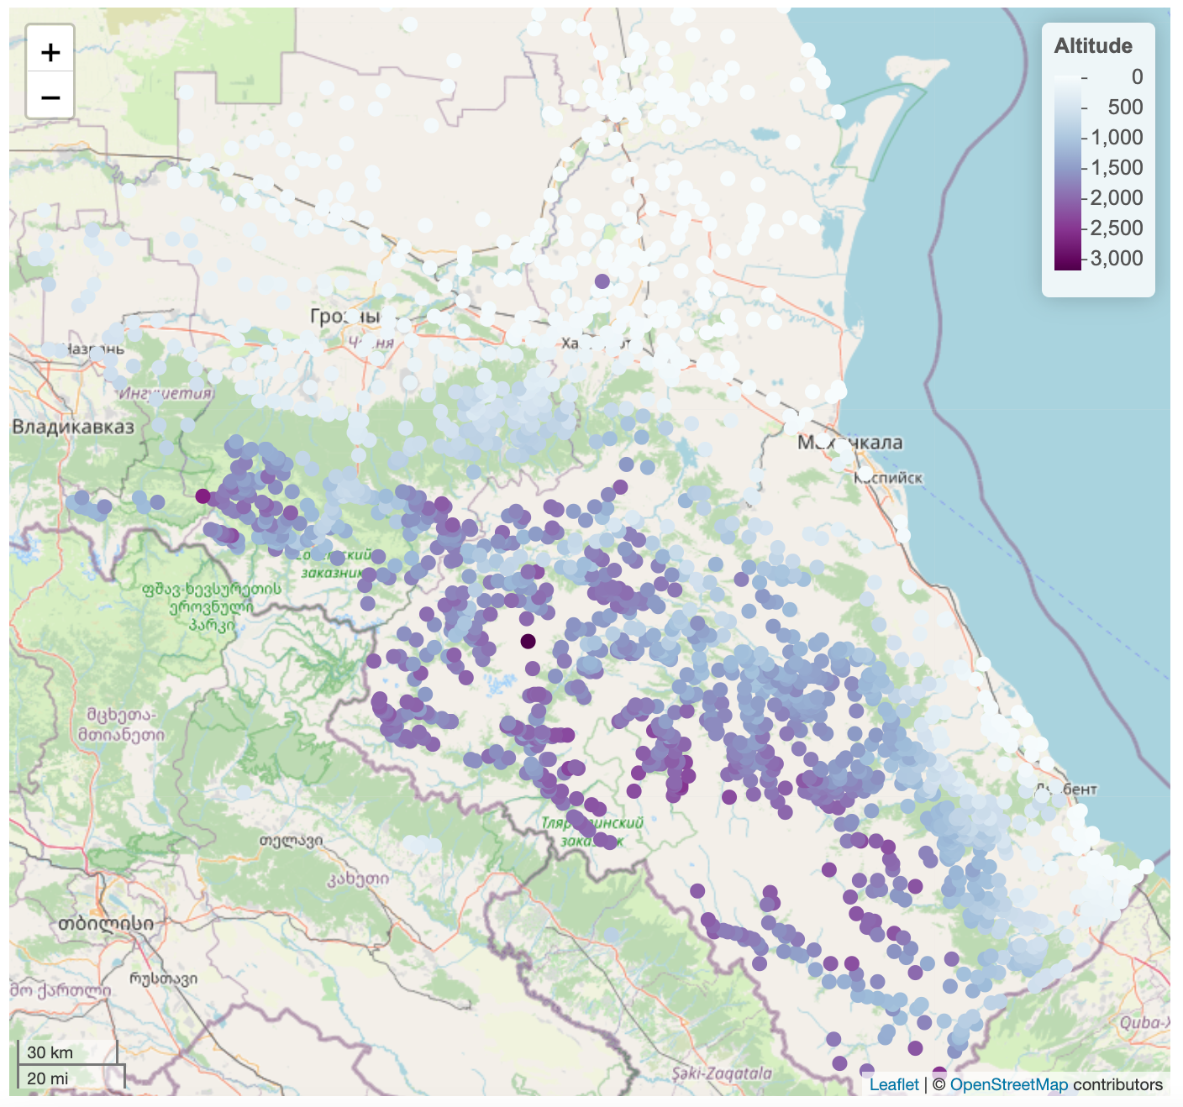
Separation metric: altitude
As a proxy for spatial separation, we used the elevation of the villages where each of the languages is spoken.
Assumedly, the higher in the mountains, the more “separated” the language.
Data on village elevation / languages come from Moroz & Verhees (2020).
Source: https://sverhees.github.io/master_villages/maps_new.html

Slide 7
Complexity metric: what measure to choose?
Information-theoretic measures:
Kolmogorov complexity (Juola 1998, 2008; Ehret & Szmrecsanyi 2016; Ehret 2018 among others)
complexity of a string is the length of the shortest possible description of that string
can be approximated by using file compression programs (e.g., gzip)
Shannon entropy (Bentz et al. 2016; Sozinova et al. 2019 among others)
a measure of (un)predictability of the particular symbol/word in a string
Measures which require annotated corpora:
Mean size of paradigm (MSP) (Xanthos & Gillis 2010)
Morphological feature entropy (MFE) (Çöltekin & Rama 2018)
Measures which do not require annotated corpora:
Type-token ratio (TTR)

Slide 8
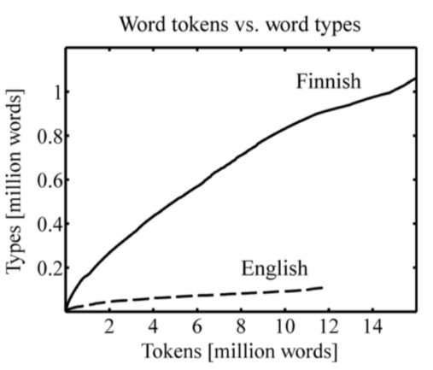
Complexity metric: type-token ratio (TTR)
Type-token ratio (TTR), usually used as a measure of lexical diversity (e.g., in studies of child language) but also reflects morphological complexity (Kettunen 2014; Gutierrez-Vasques & Mijangos 2020 among others).
TTR depends on the corpus size (Heap’s law)
TTR | = | the number of types
 |  | the number of tokens
(Creutz & Lagus 2007: 21)

Slide 9
Complexity metric: type-token ratio (TTR)
The general idea of the metric: how many element types do we need to produce the text of n elements?
This is equivalent to TTR(n) where n is fixed across languages
In this study we calculate
TTR for phonemes (henceforth TTRph),
TTR for syllables (henceforth TTRs),
TTR for wordforms (henceforth TTRw).

Slide 10
TTR for phonemes and altitude

Slide 11
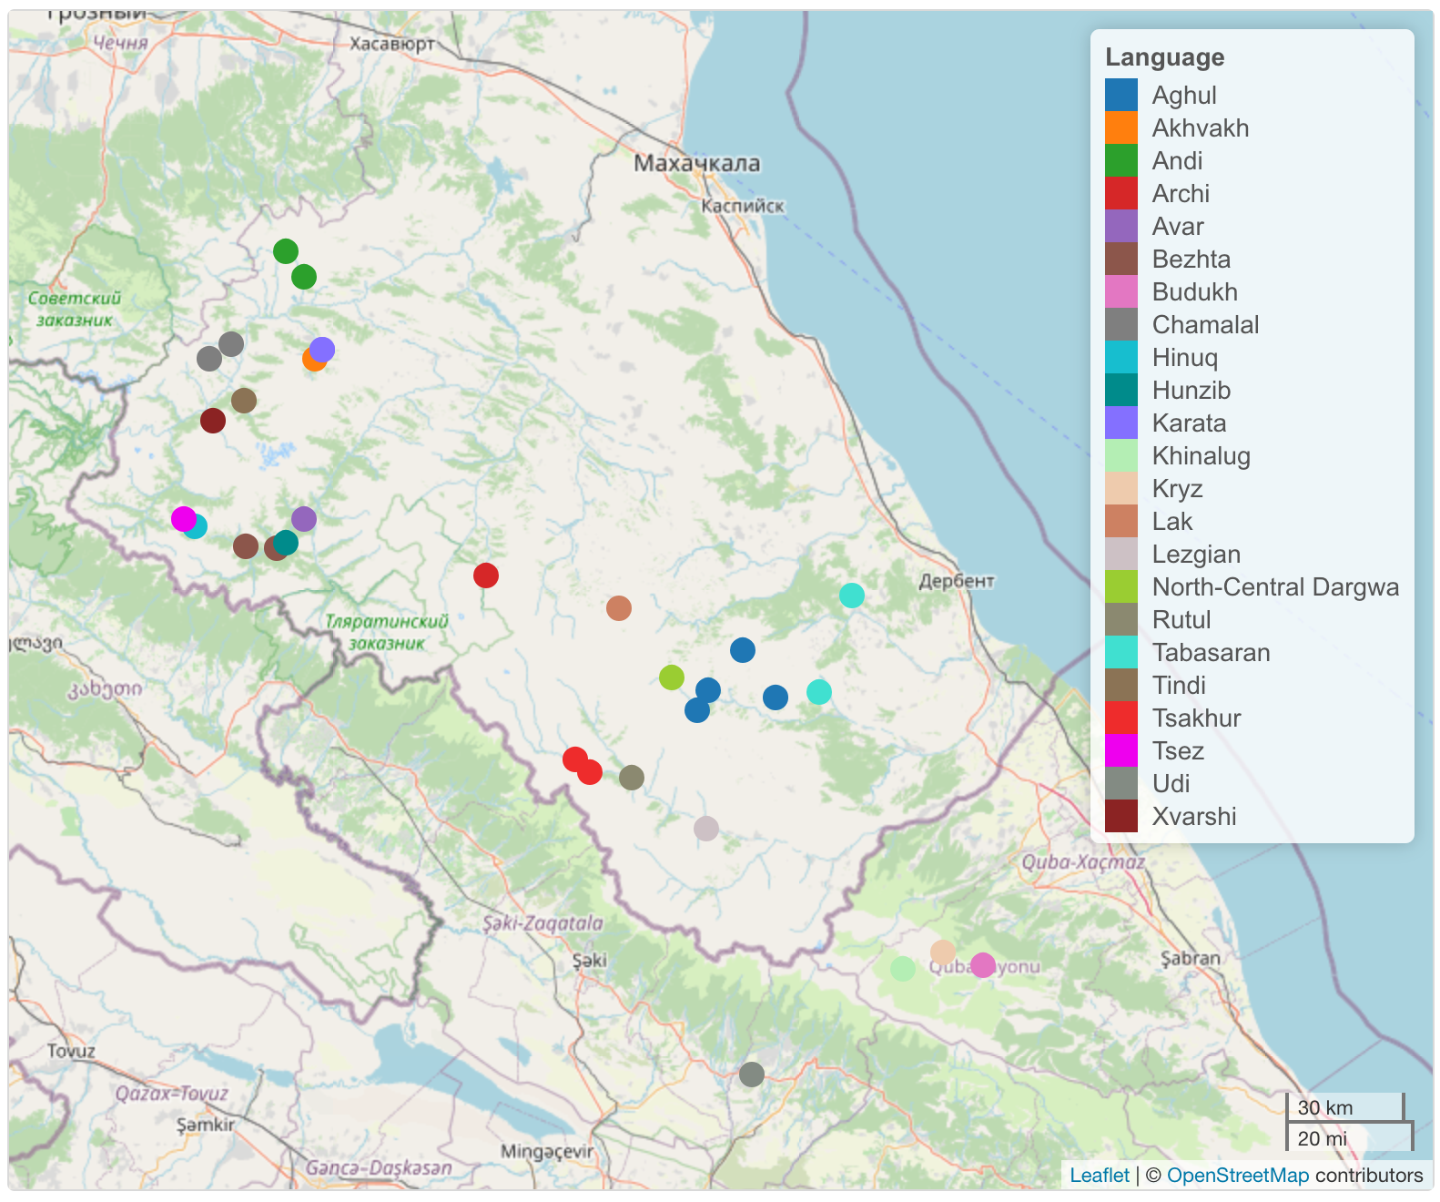
Data: KiKo
The KiKo database:
a lexical database of 40 lects of East Caucasian (Nakh-Daghestanian), based on the comparative dictionary (Kibrik, Kodzasov 1990) with addition of more recently obtained comparable field data.
NB: for some of the lects the data on division of words into segments is incomplete.
In this study we use the data for 32 lects shown on the map.
the map is created with the R package Lingtypology (Moroz 2017)

Slide 12
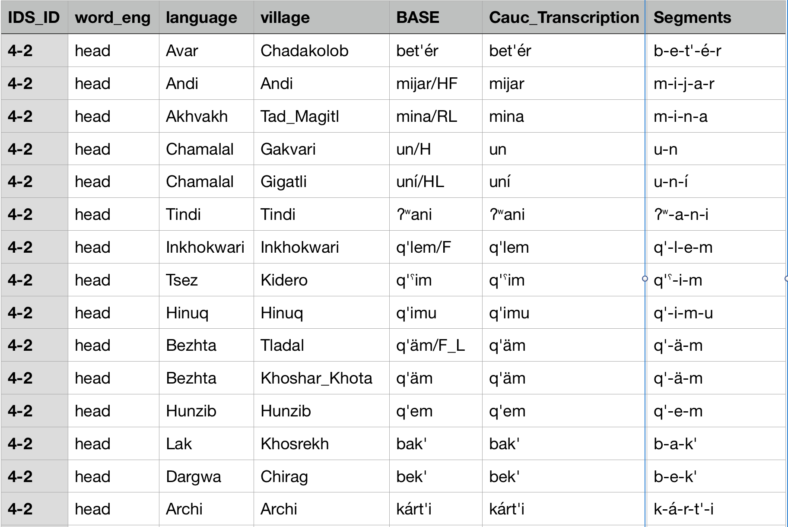
KiKo phonemes: overview
The Kiko database is organized as parallel wordlists.
~ 500 word tokens per lect (“village”) → ~ 2,500 phoneme tokens per lect (“village”)
Notes:
На этом слайде вторая строчка не очень-то понятна - поясните ее голосом когда будете рассказывать (или распишите лучше тоже)

Slide 13
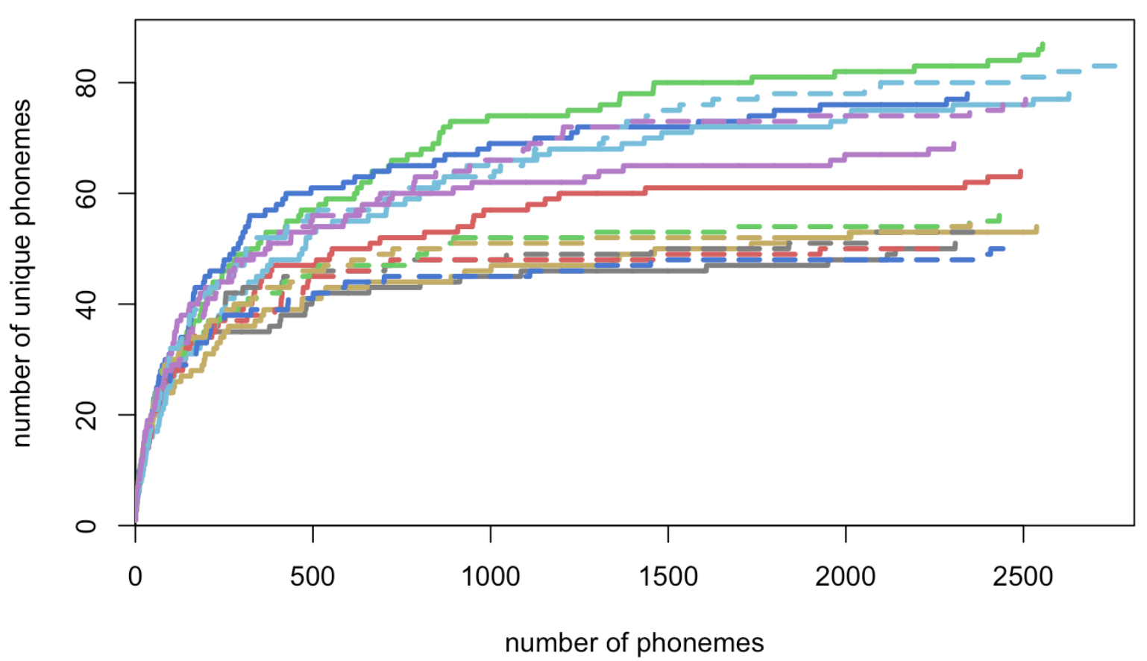
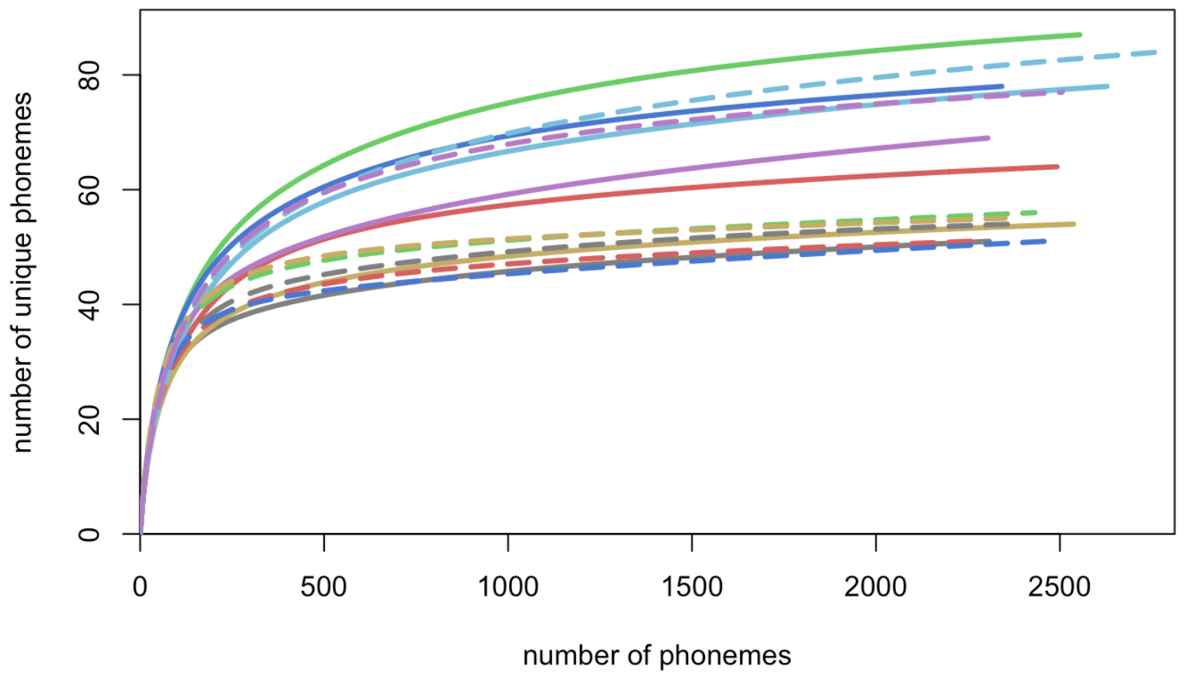
Interpolation of curves
An empirical curve of the growth of the phonologically inventory can be changed to the expected curve based on the frequency list of the corpus.
Interpolated curves do not depend on the order of the elements in the corpus.
The growth of phonological inventory with increasing corpus size (observed)
The growth of phonological inventory with increasing corpus size (expected)
Notes:
Здесь надо по-хорошему процитировать пакет, с помощью которого графики нарисованы
МД: ну кстати здесь видно что и по их формуле кривые могут пересекаться

Slide 14
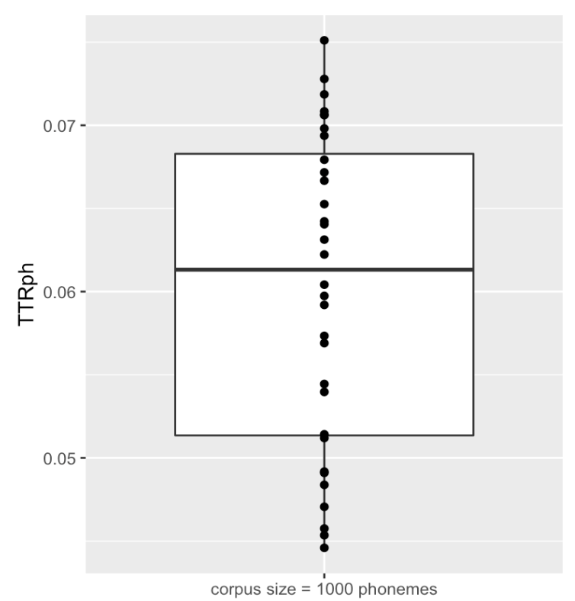
TTRph when the total number of phonemes = 1000
For each language, we extract the TTR value at the interpolation for the corpus size equal to 1,000 phonemes.

Slide 15
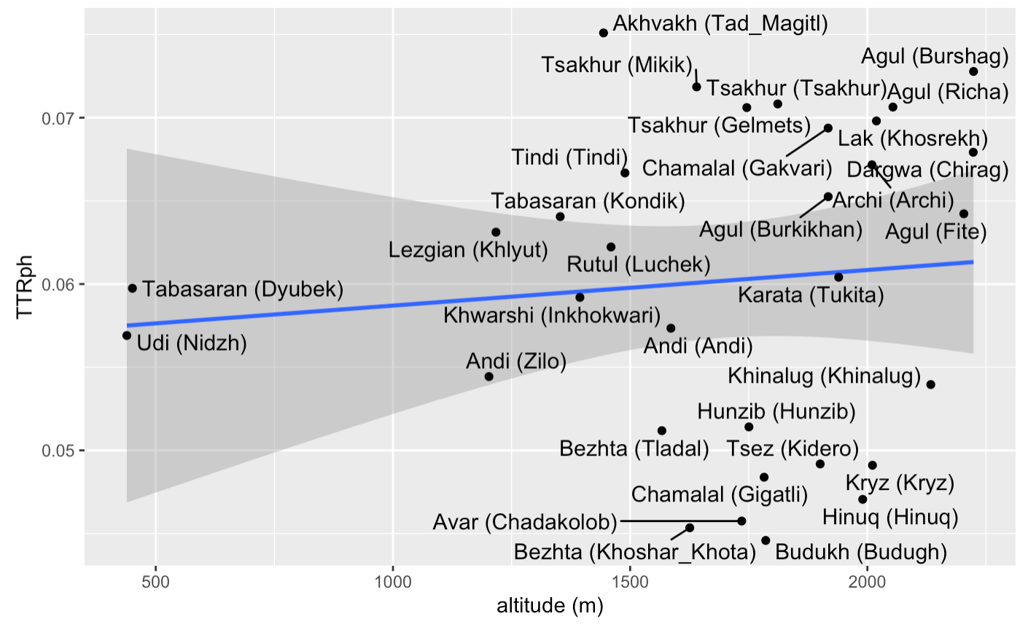
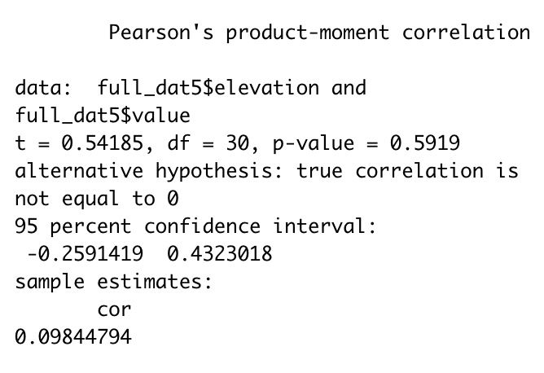
TTRph and altitude: correlation coefficient
No correlation between TTRph and altitude has been found.

Slide 16
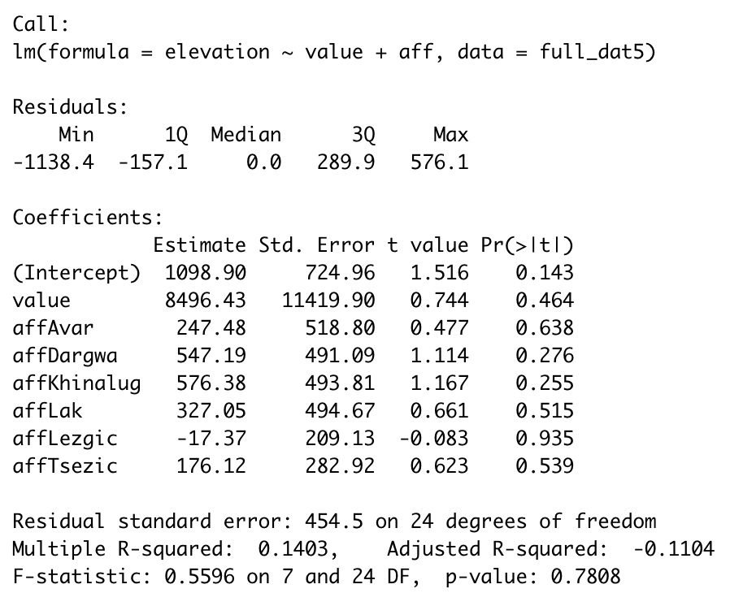
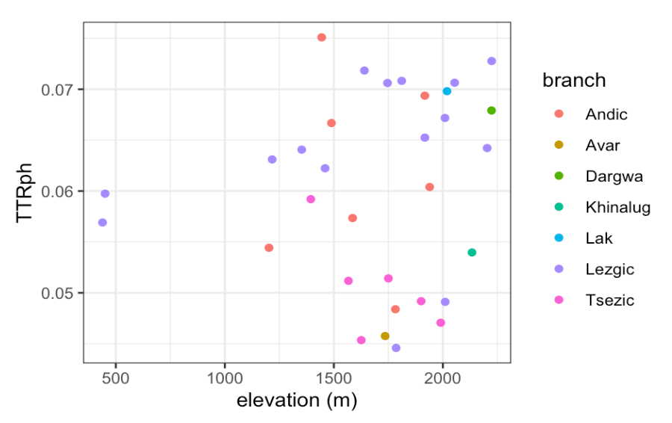
TTRph and altitude: linear regression
To exclude possible genealogical signal at the level of branches, genealogical affiliation is included to the linear regression formula as fixed effects.
No significant dependency has been found.

Slide 17
TTR for syllables and altitude

Slide 18
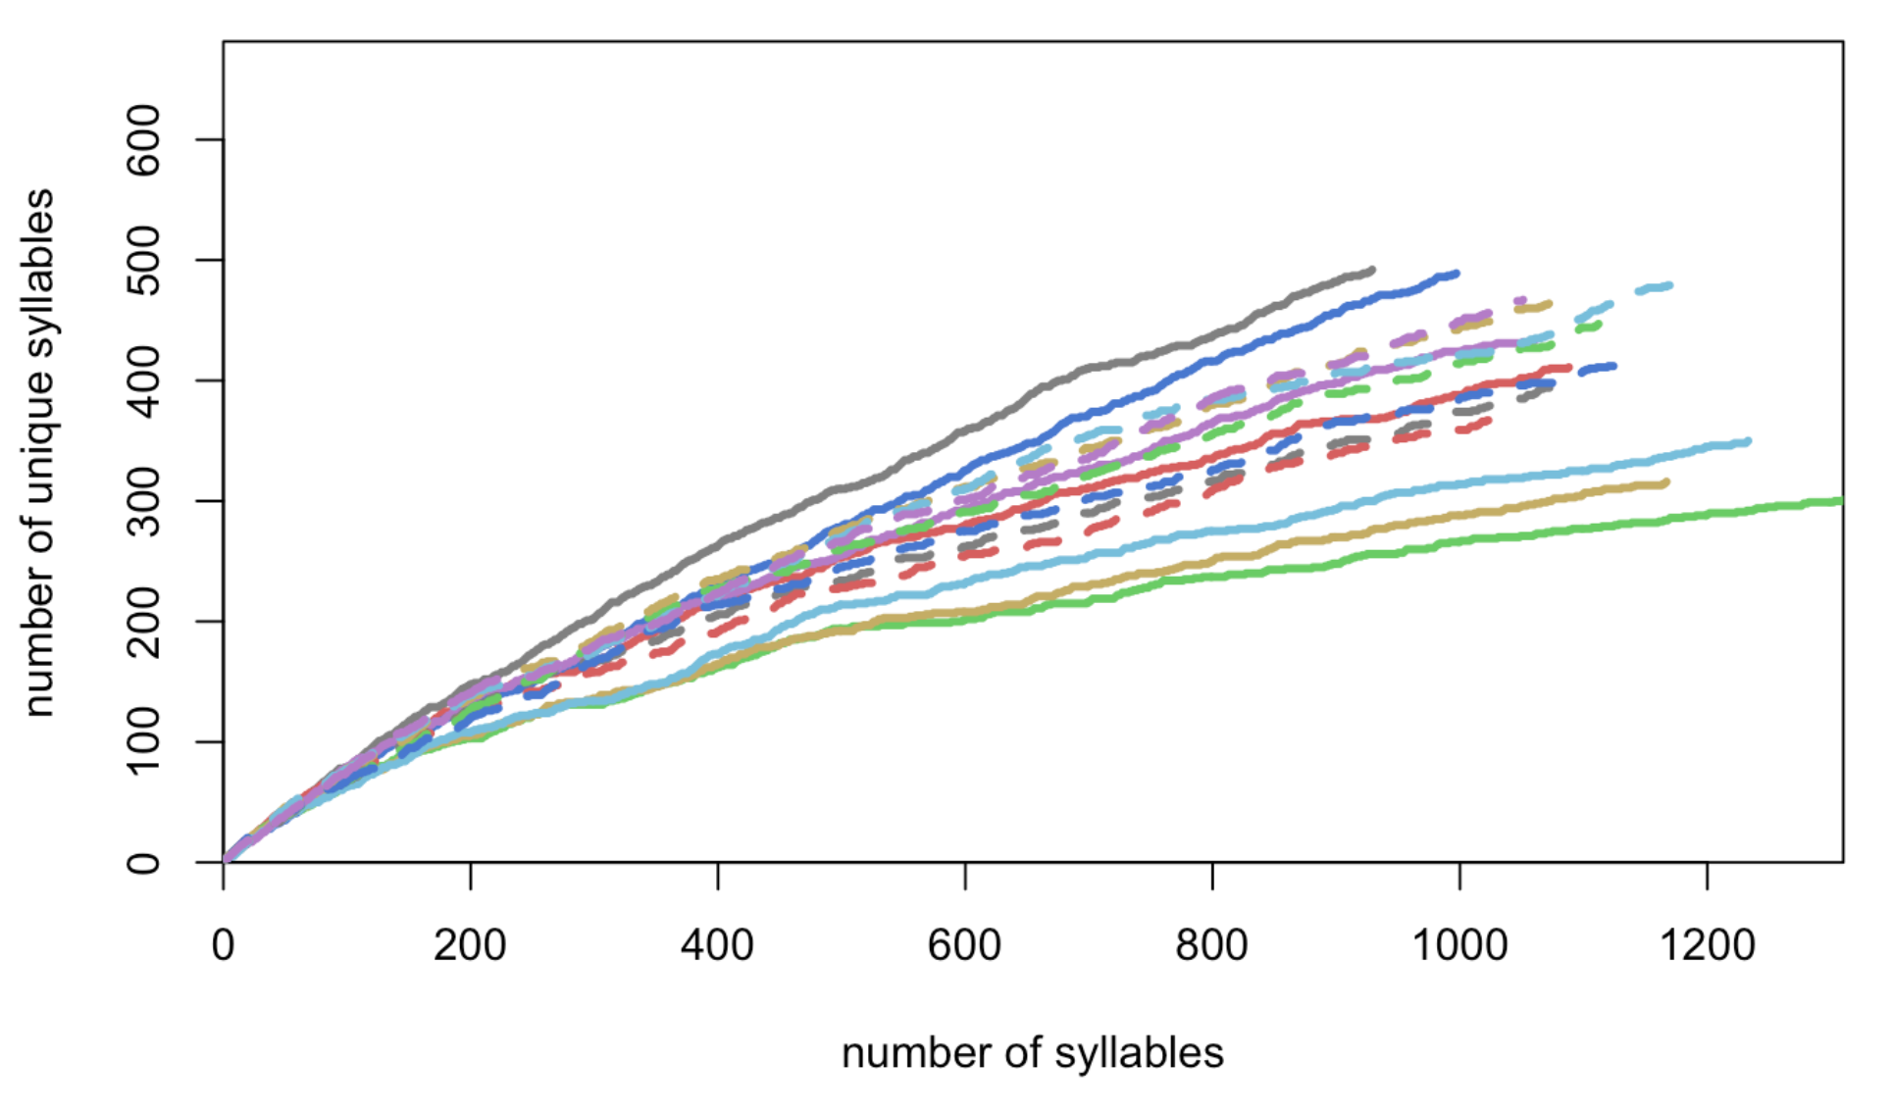
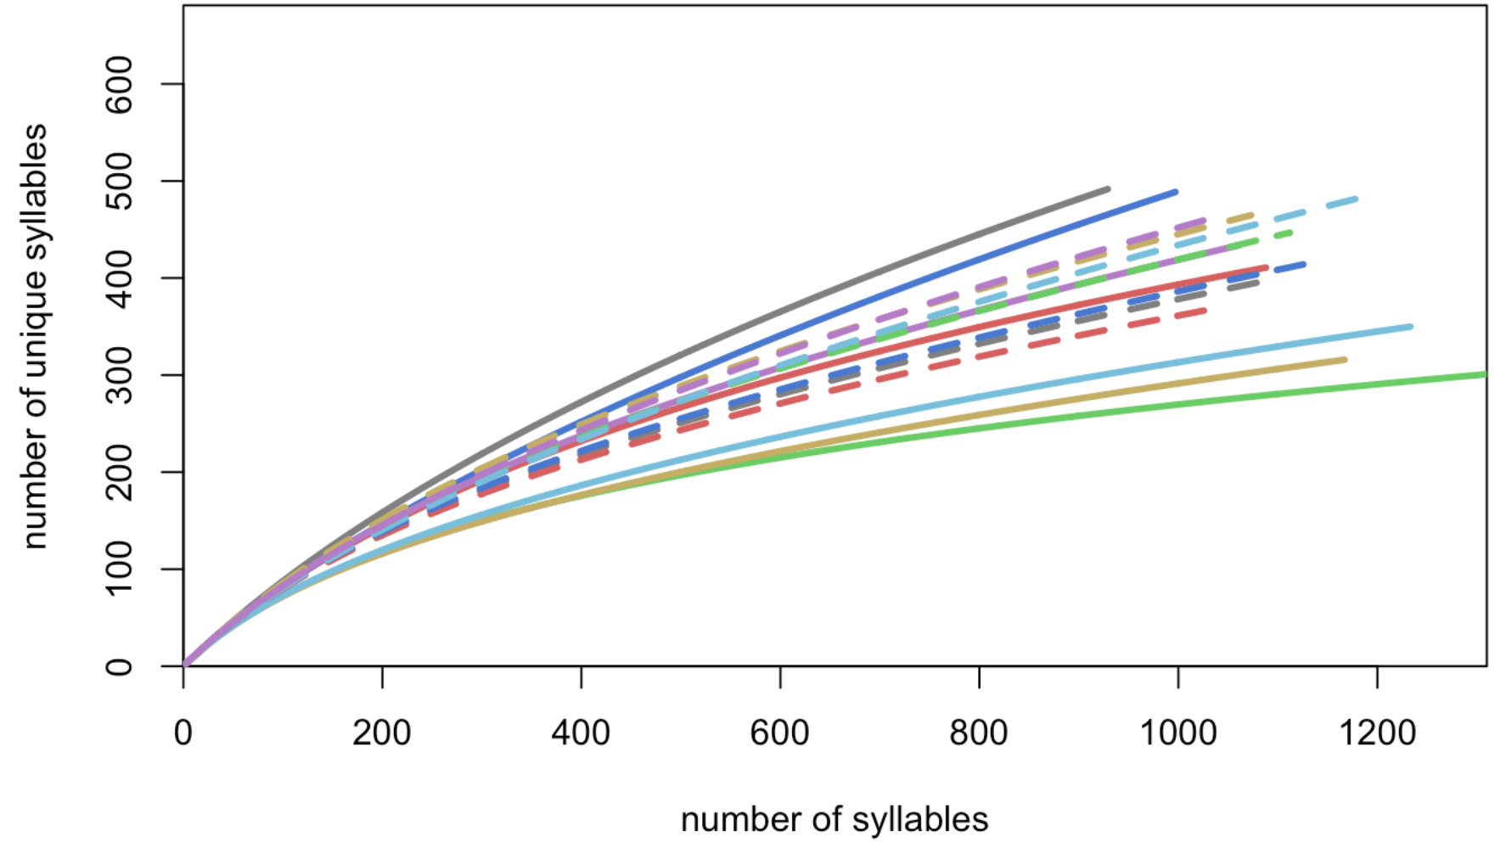
KiKo syllables: interpolation of curves
~ 500 words per lect (“village”) → ~ 1000 syllables per lect (“village”)
Similarly to the analysis of phonemes, we redraw the growth curves to exclude the factor of the order of syllables in the corpus
The growth of syllabic inventory with increasing corpus size (observed)
The growth of syllabic inventory with increasing corpus size (expected)

Slide 19
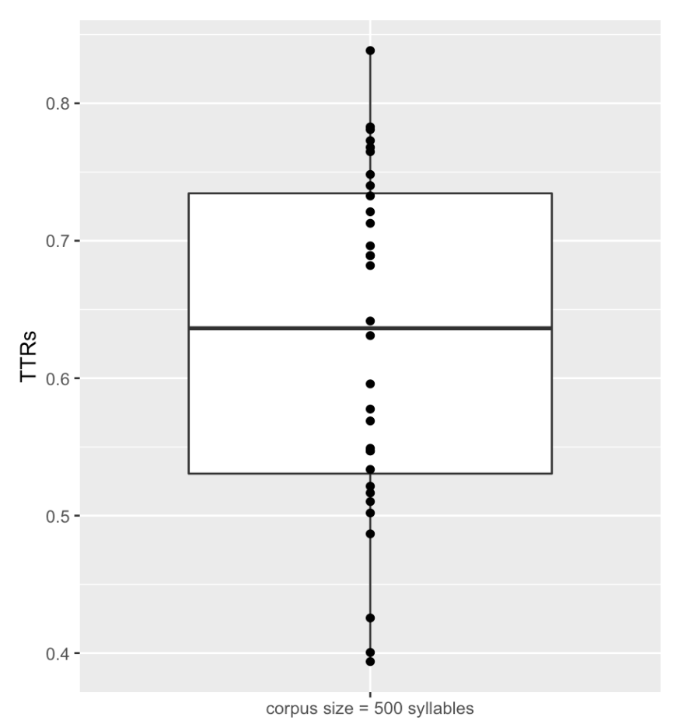
TTRs when the total number of syllables = 500
For each language, we extract the TTR value at the interpolation for the corpus size equal to 500 syllables.

Slide 20
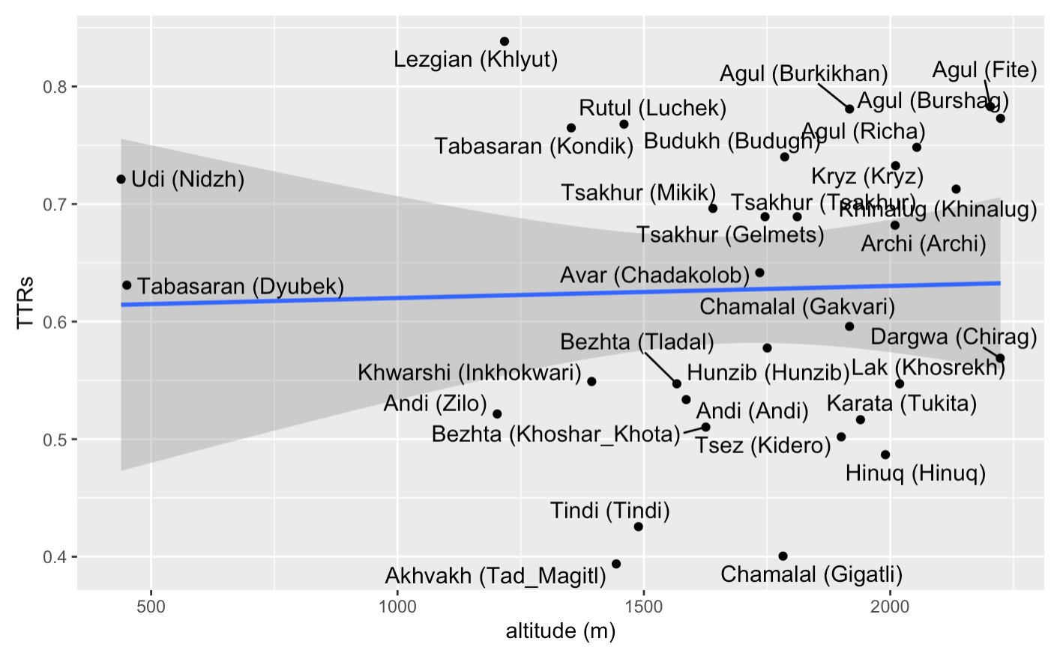
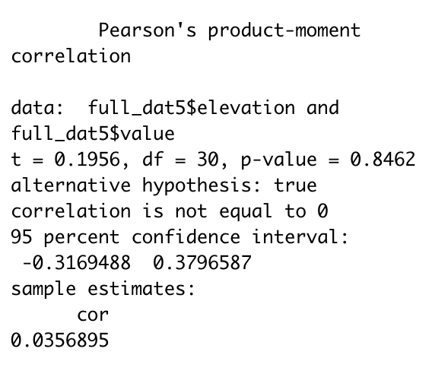
TTRs and altitude: correlation coefficient
No correlation between TTRs and altitude has been found.

Slide 21
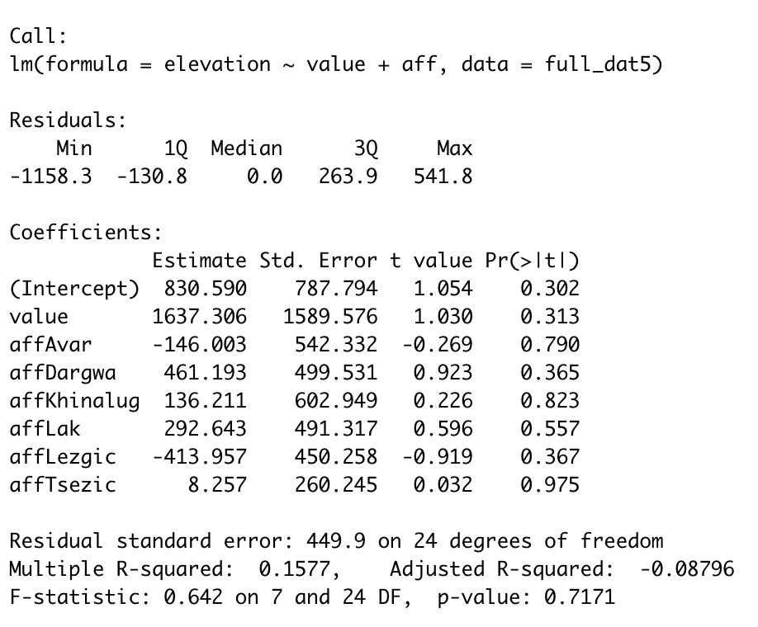
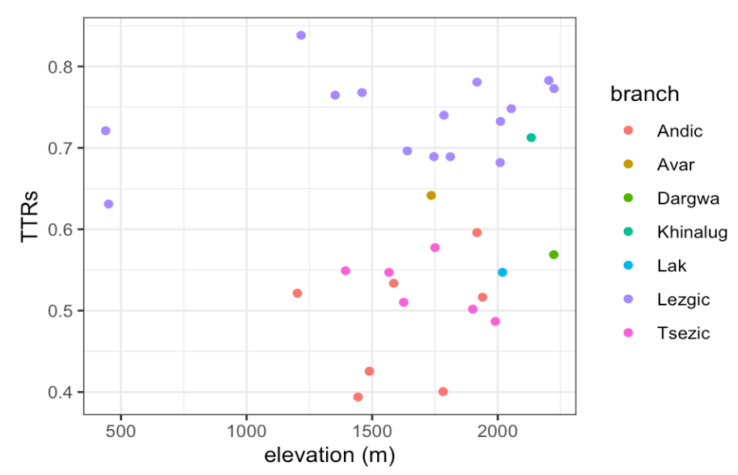
TTRs and altitude: linear regression
To exclude possible genealogical signal at the level of branches, genealogical affiliation is included to the linear regression formula as fixed effects.
No significant dependency has been found.

Slide 22
TTR for wordforms and altitude

Slide 23
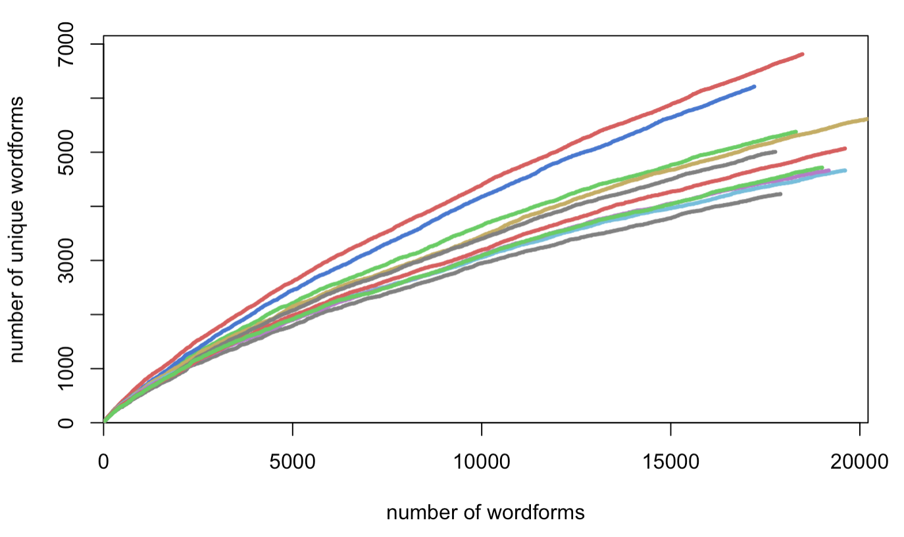
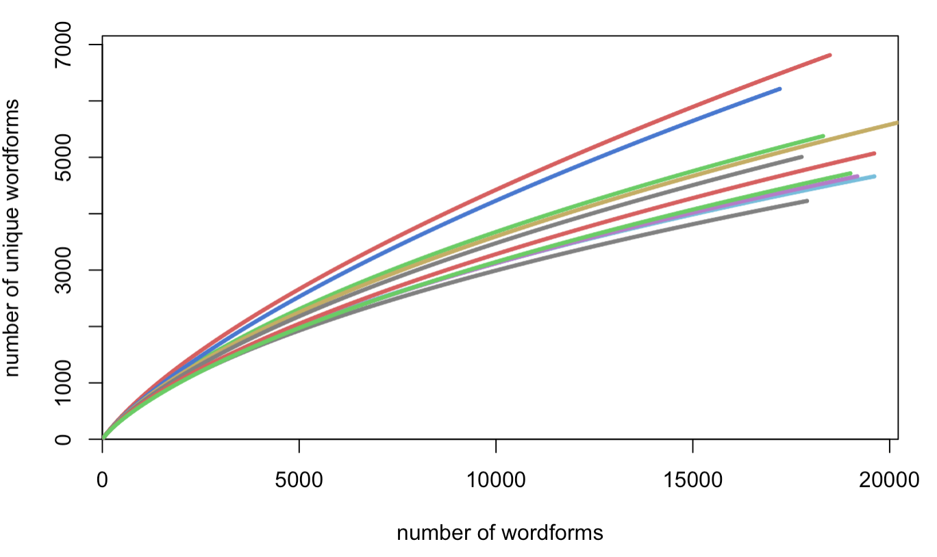
Translations of the Gospel of Luke: interpolation of curves
9 languages, each translation ~ 18 thousand tokens
Similarly to the previous analyses, we substituted the real curves with their interpolations
The growth of the number of wordforms types with increasing corpus size (observed)
The growth of the number of wordforms types with increasing corpus size (expected)

Slide 24
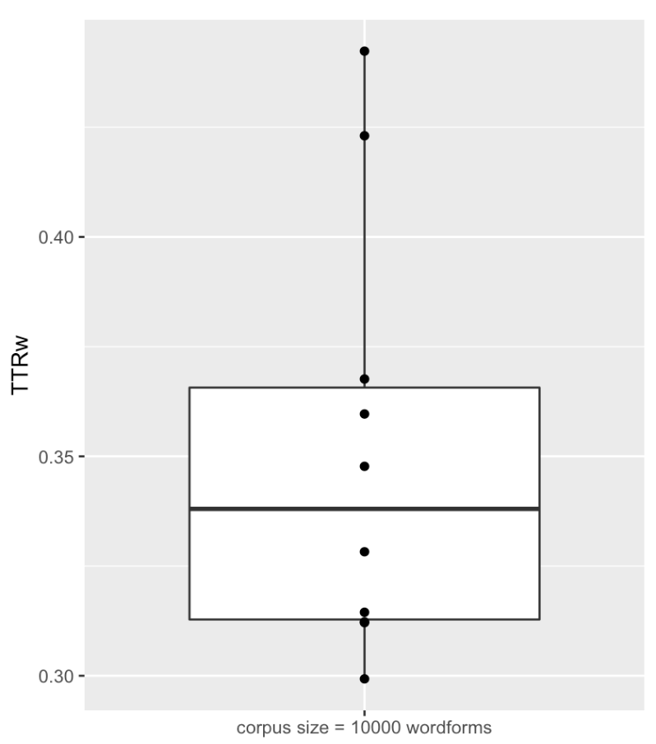
TTRw when the total number of tokens = 10000
For each language, we extract the TTR value at the interpolation for the corpus size equal to 10,000 wordforms.

Slide 25
TTRw and altitude
In contrast to the KiKo data, translations of the Gospel of Luke cannot be associated with particular villages. What altitude values should we choose in this case?
We calculate altitude as a weighted arithmetic mean taking into account how many speakers of the given language live in the villages located at different altitudes.
The data on population size of Daghestanian villages come from Census 2010 (https://multidagestan.com/census)
Notes:
А разве не из того же датасета с высотностями? Она там тоже вроде бы была

Slide 26
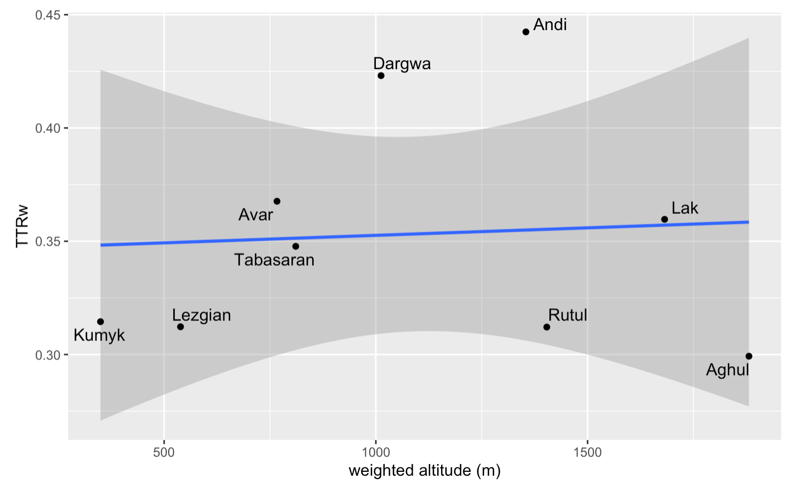
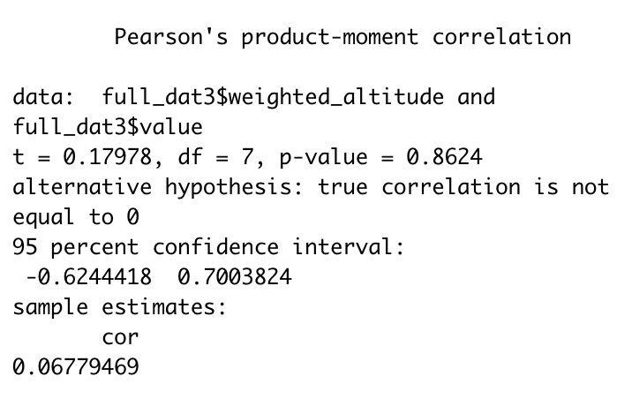
TTRw and altitude: correlation coefficient
No correlation between TTRw and altitude has been found.

Slide 27
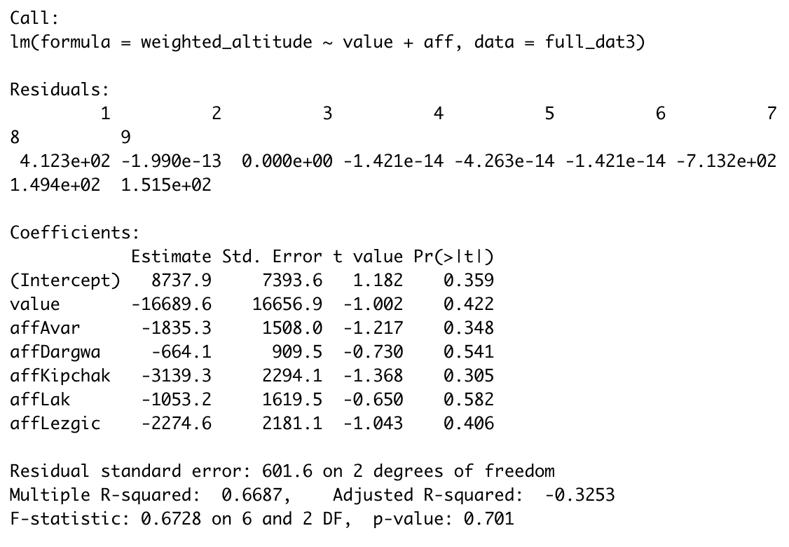
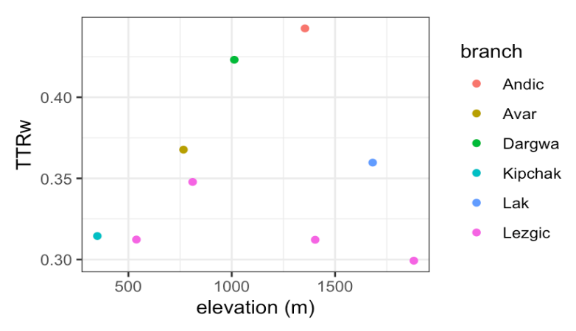
TTRw and altitude: linear regression
To exclude possible genealogical signal at the level of branches, genealogical affiliation is included to the linear regression formula as fixed effects.
No significant dependency has been found.

Slide 28
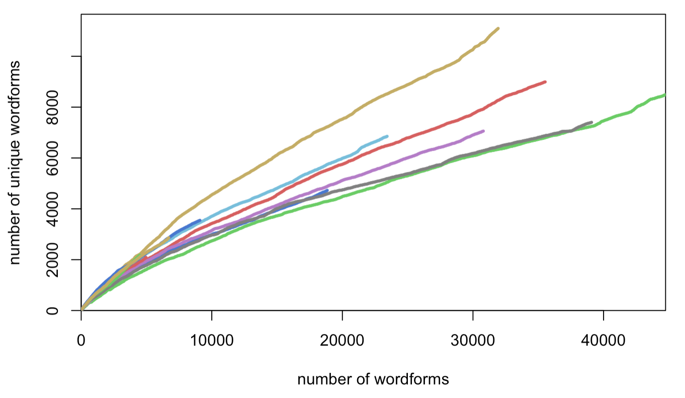
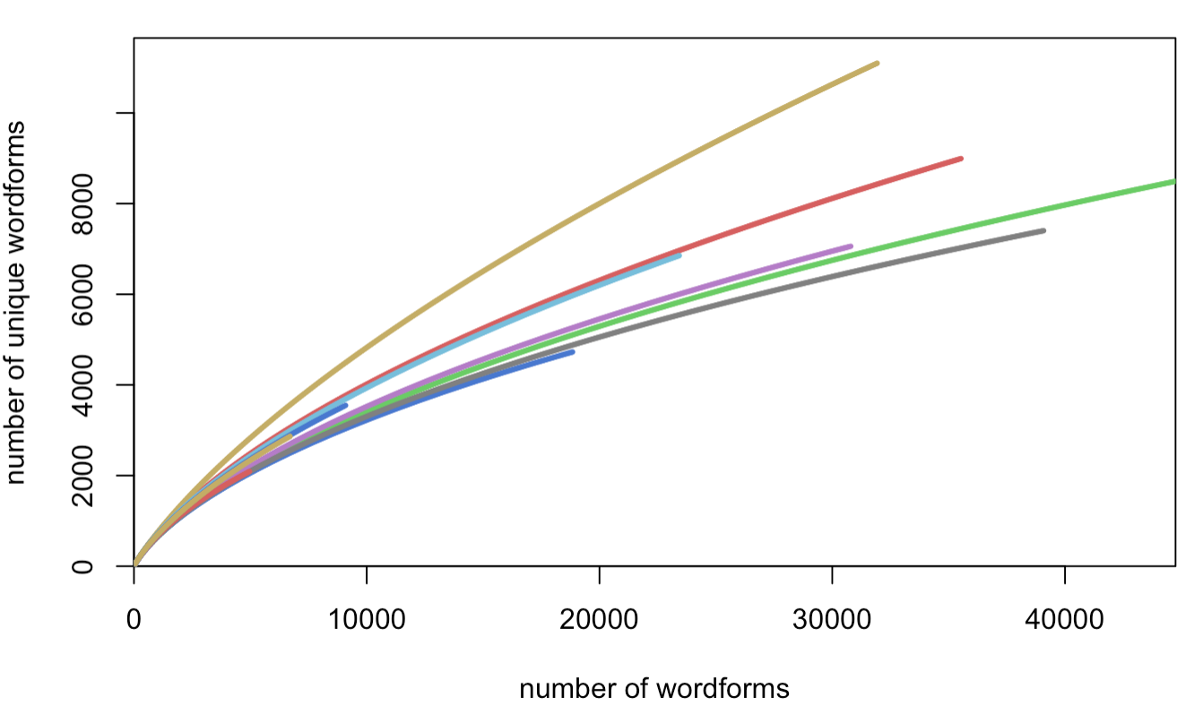
Folklore texts: interpolation of curves
Data from four volumes of the series “Pamyatniki folklora narodov Dagestana” [Folklore of the peoples of Dagestan], folklore texts from 12+ languages with translations to Russian.
The growth of the number of wordforms types with increasing corpus size (observed)
The growth of the number of wordforms types with increasing corpus size (expected)
Notes:
Странно, что здесь на правом графике у нас интерполированные кривые не доведены до конца - все равно же интерполируем

Slide 29
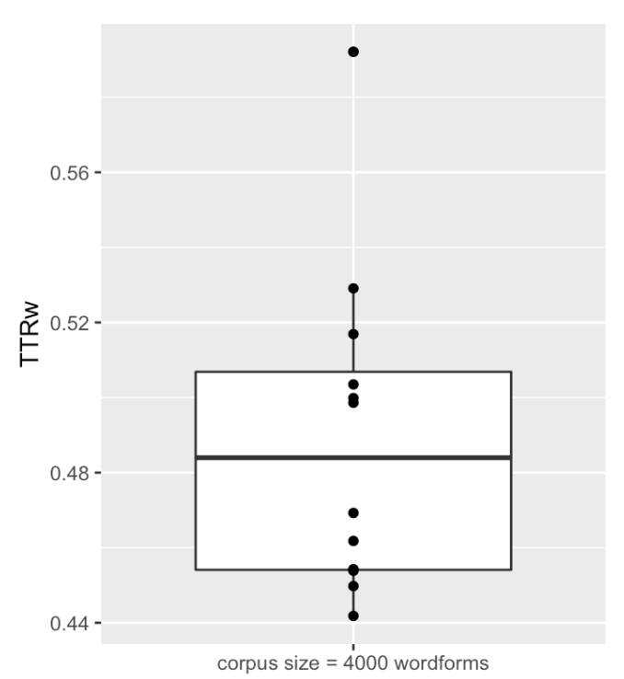
TTRw when the total number of tokens = 4000
For each language, we extract the TTR value at the interpolation for the corpus size equal to 4,000 wordforms.
Notes:
Ну опять же, тут не совсем ясно - если мы все равно экстраполируем, то почему нужен маленький срез.
И как мы берем 4,000

Slide 30
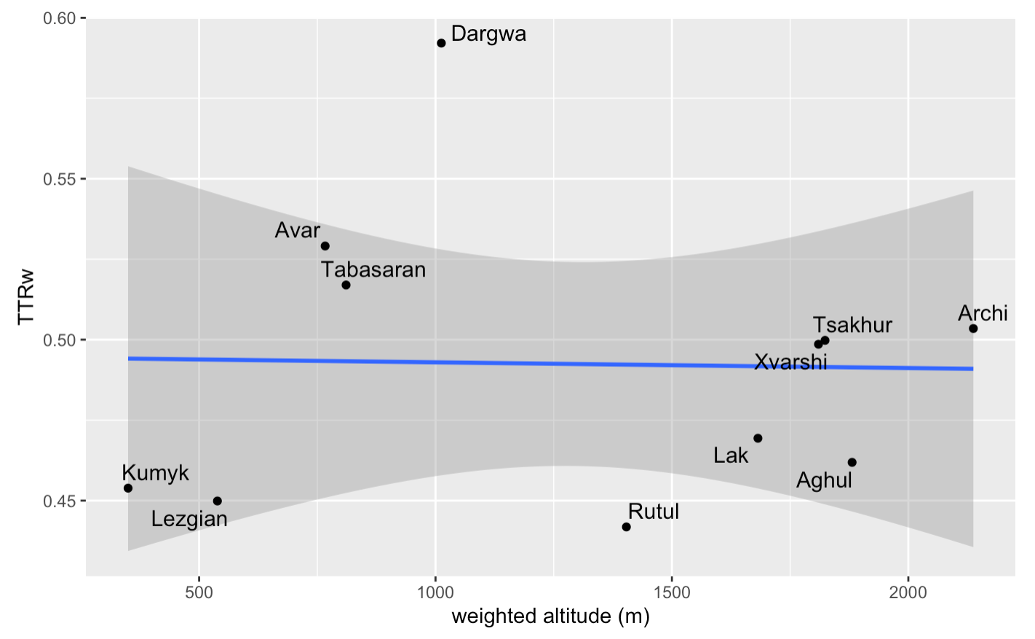
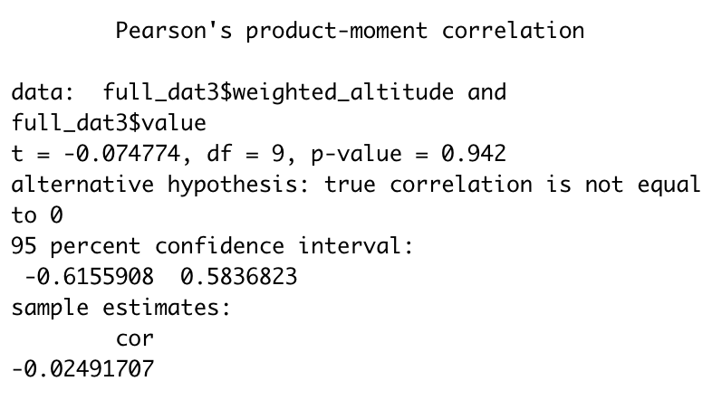
TTRw and altitude: correlation coefficient
No correlation between TTRw and altitude has been found.

Slide 31
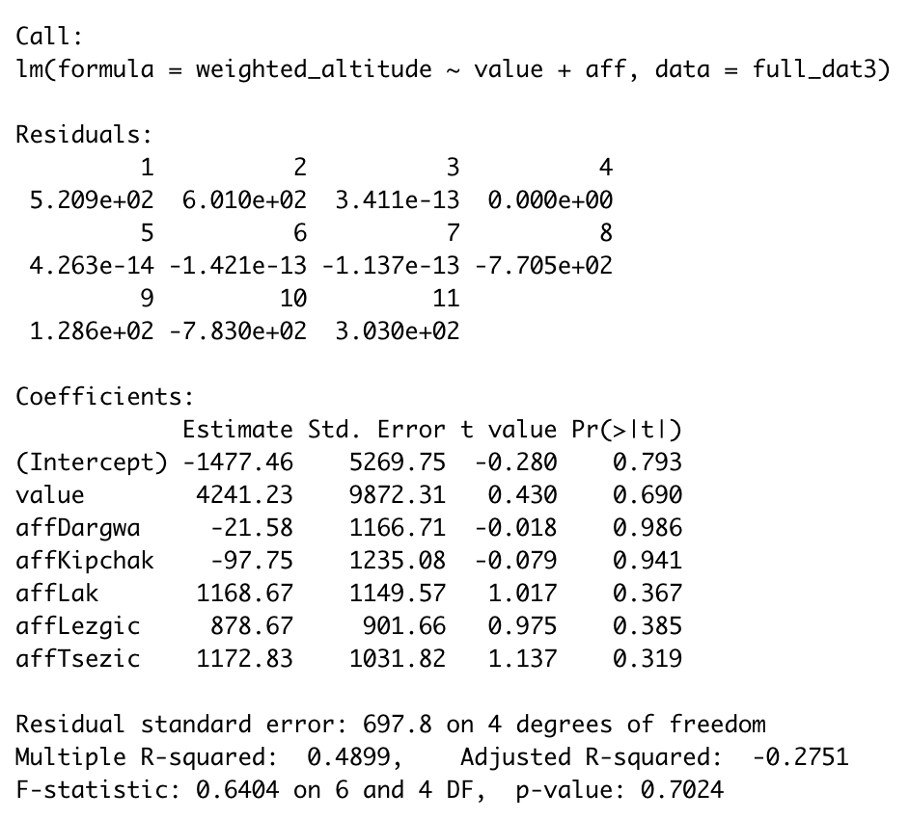
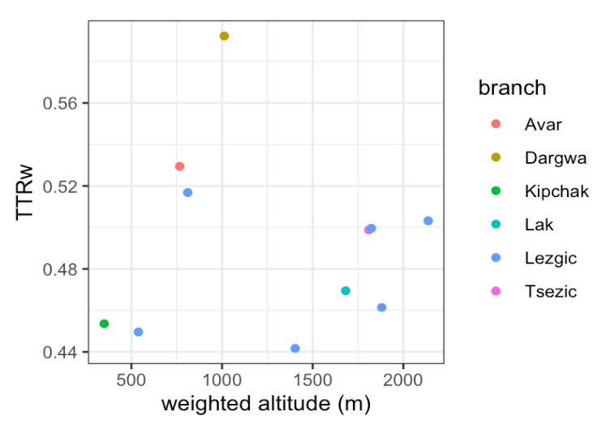
TTRw and altitude: linear regression
To exclude possible genealogical signal at the level of branches, genealogical affiliation is included to the linear regression formula as fixed effects.
No significant dependency has been found.

Slide 32
Discussion: TTR variance

Slide 33
TTR variance
When we extract TTR values at the particular corpus size, we take only one datapoint per language. However, how exact is this datapoint?
We check this by sampling the original (not interpolated) data and looking at the variance of obtained TTR values.

Slide 34
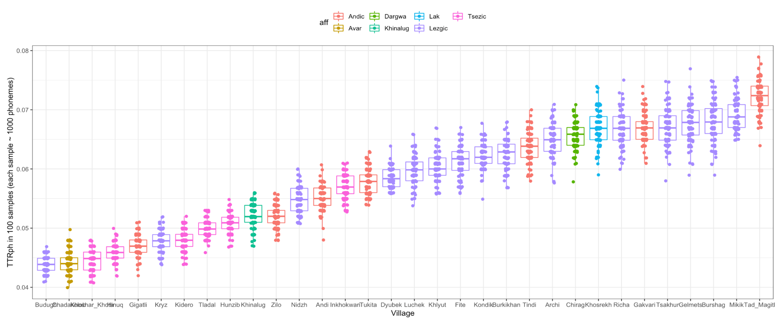
TTR variance
For example, in case of KiKo phonemes, we take 100 samples of words with the total number of phonemes approximately equal to 1000 and calculate TTRph in each sample.

Slide 35
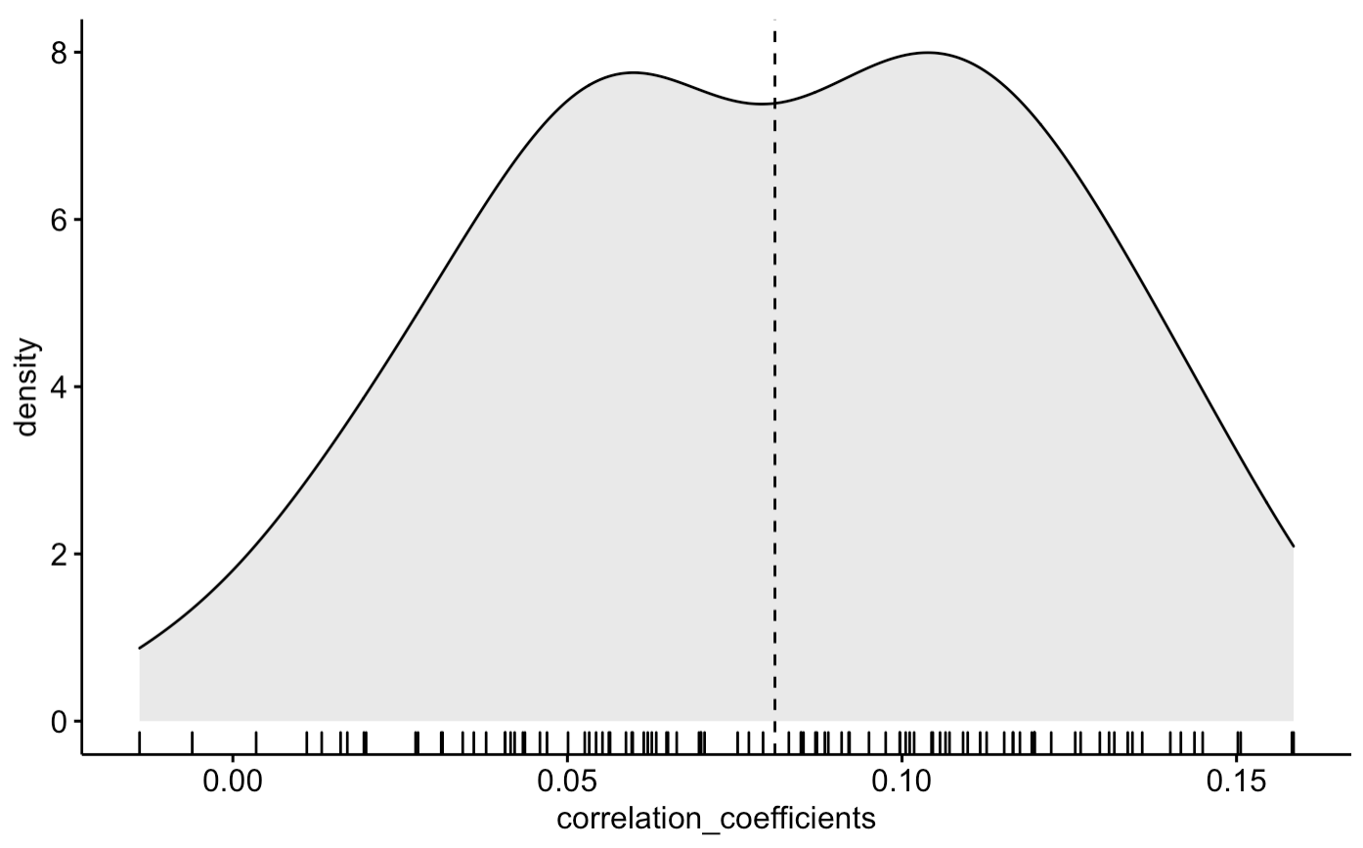
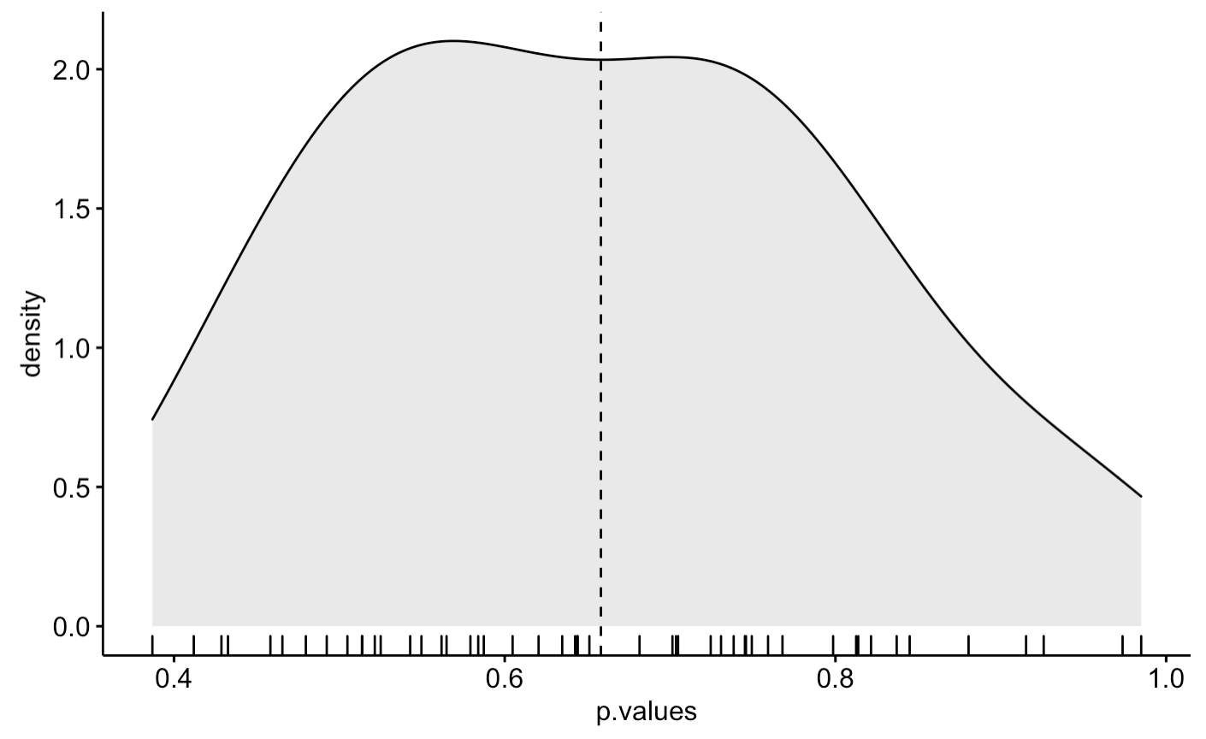
Correlation coefficients in individual samples: phonemes
After that we get not one correlation coefficient but 100 correlation coefficients between TTRph and altitude for each of 100 samples. Interestingly, in case of phonemes, positive correlation appears to be rather stable, however, the high p-values do not allow us to trust this result.
Distribution of correlation coefficients
Distribution of p-values of correlation coefficients

Slide 36
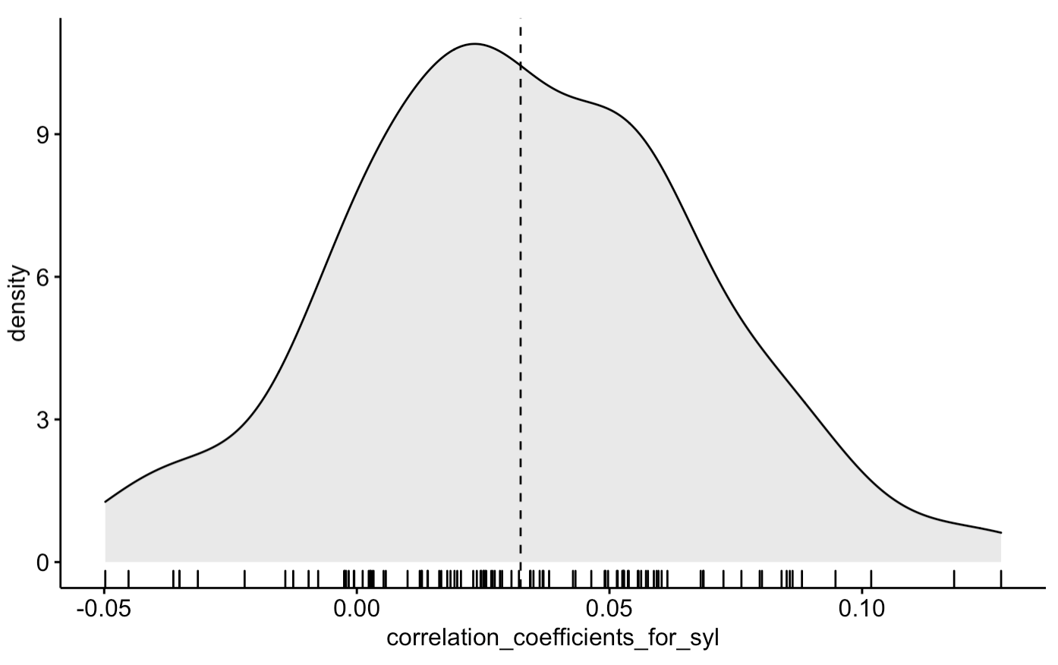
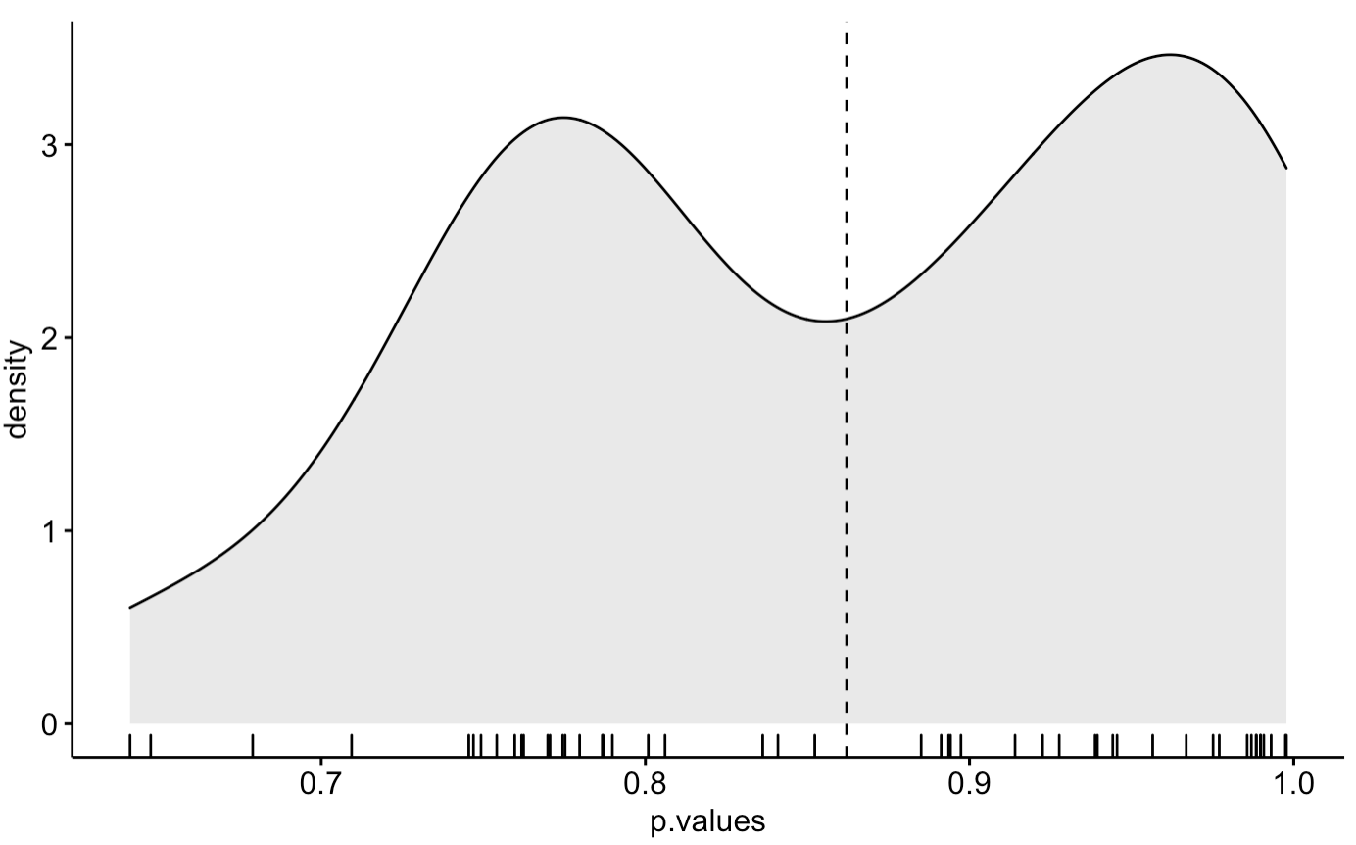
Correlation coefficients in individual samples: syllables
Results for KiKo syllables: correlation coefficients for 100 samples of words with the total number of syllables approximately equal to 500. No correlation is observed.
Distribution of correlation coefficients
Distribution of p-values of correlation coefficients

Slide 37
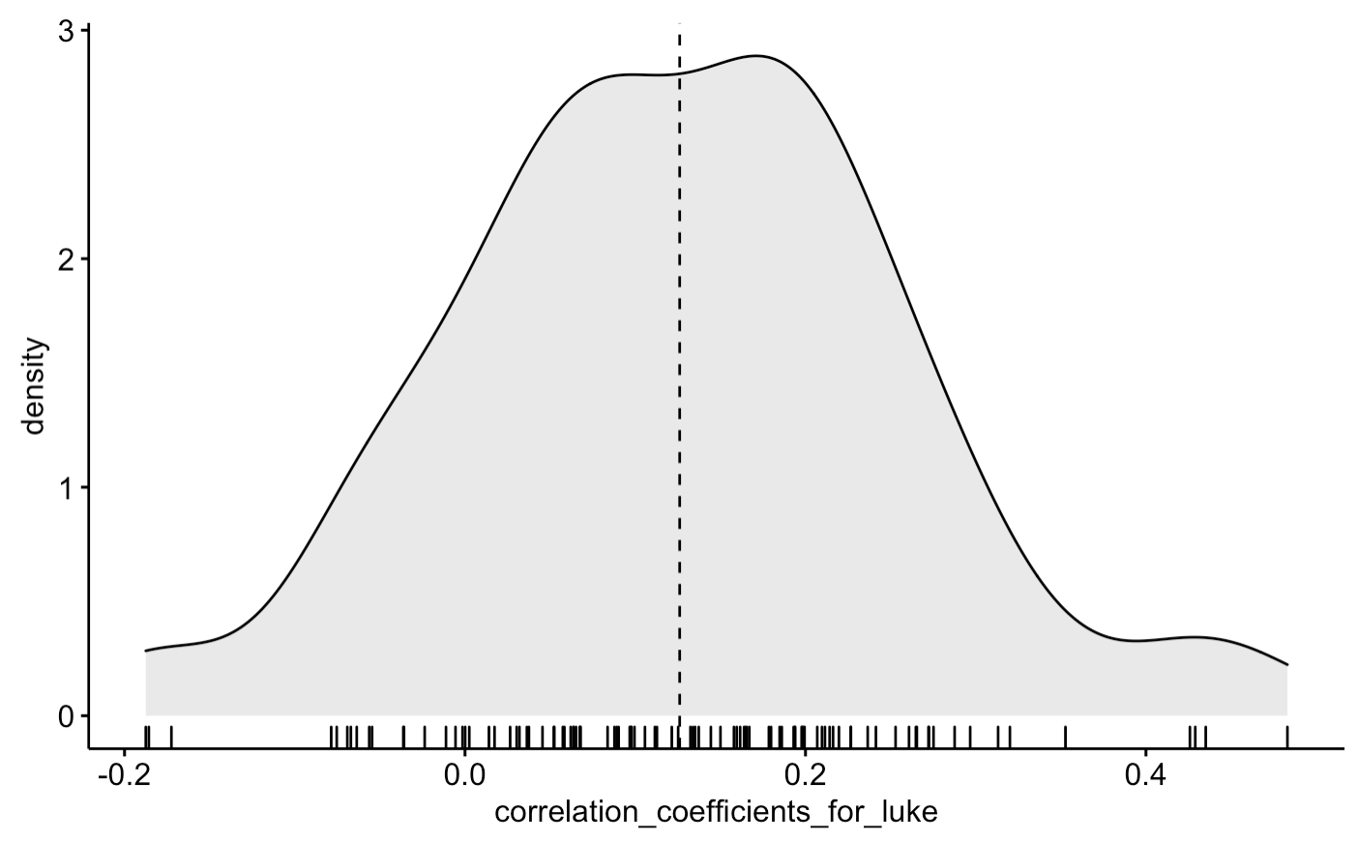
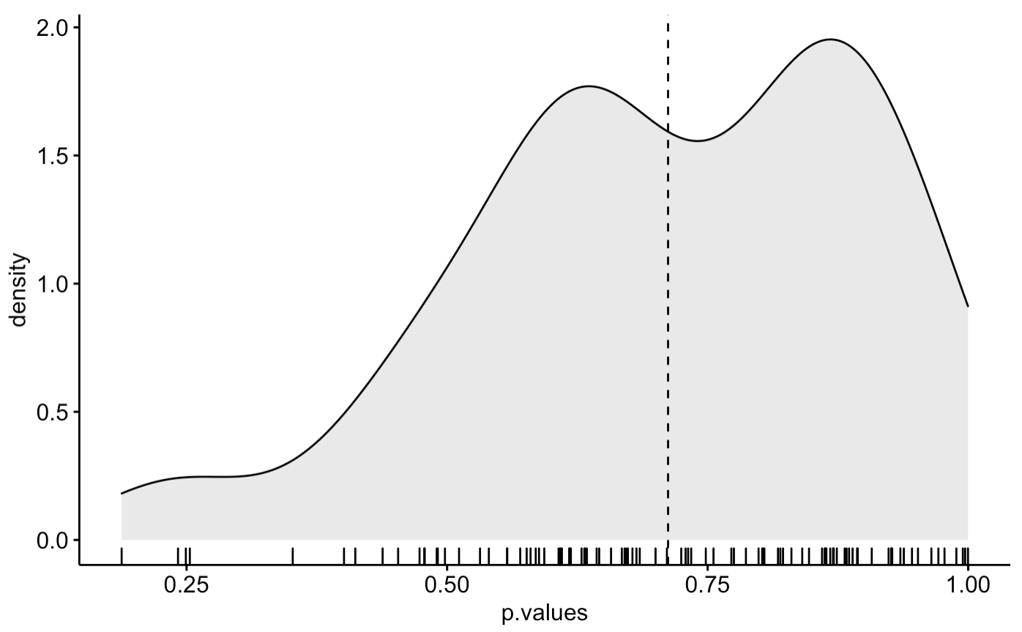
Correlation coefficients in individual samples: wordforms
Results for translations of the Gospel of Luke: correlation coefficients for 100 samples of sentences with the total number of wordforms approximately equal to 1000. No correlation is observed.
Distribution of correlation coefficients
Distribution of p-values of correlation coefficients

Slide 38
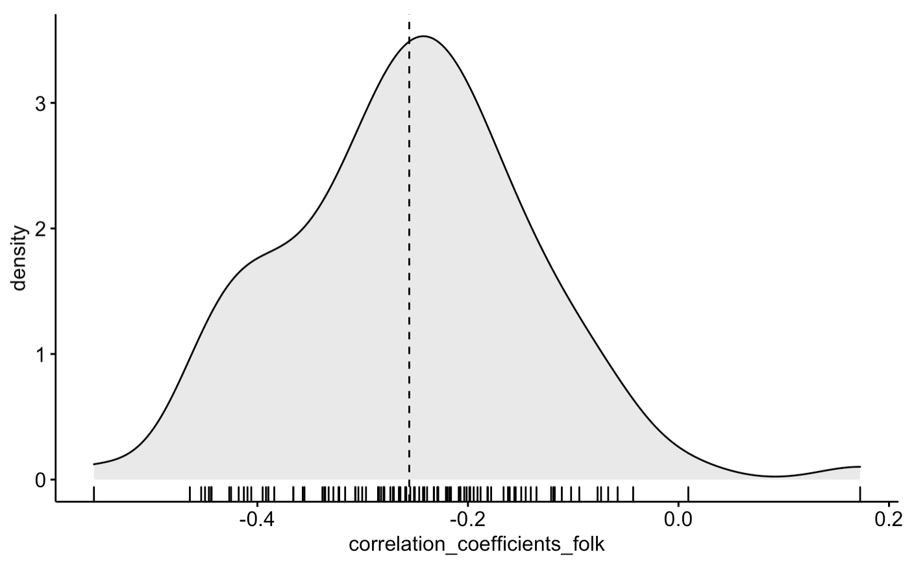
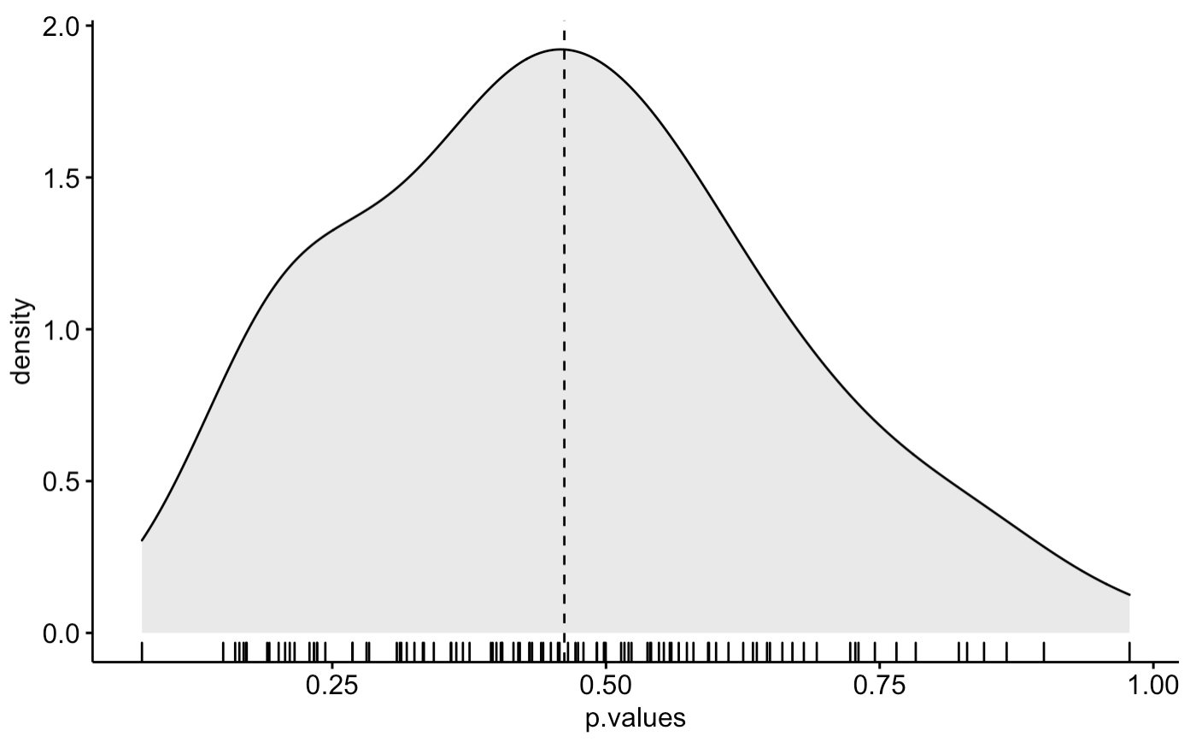
Correlation coefficients in individual samples: wordforms
Results for folklore texts: correlation coefficients for 100 samples of sentences with the total number of wordforms approximately equal to 1000. Here the correlation is negative, with high p-values.
Distribution of correlation coefficients
Distribution of p-values of correlation coefficients

Slide 39
Conclusion

Slide 40
Conclusion
Our study does not support the hypothesis on the correlation between complexity of the language and the degree of separation of the speech community on the local level - for Daghestanian languages.

Slide 41
Conclusion
There is a probability that the absence of correlations in our data is due to the methodology of the study, e.g.,
altitude is a poor proxy for separation (need for social separation metrics, but we do not have them)
we have not enough linguistic data (corpora are too small)
impact of inherited complexity is too strong to detect the effect of sociospatial separation
more sensitive statistical tools can be used

Slide 42
Conclusion
Our interpretation of linguistic complexity (how many element types do we need to produce the text of n elements) is not the same as by Trudgill 2011 and Nichols 2020 (systemic complexity).
However, measuring Trudgill’s or Nichols’ complexities by fully objective methods has been problematized by Joseph (2021).

Slide 43
Conclusion
Our study does not support the hypothesis on the correlation between complexity of the language and the degree of separation of the speech community on the local level - for Daghestanian languages.
The results of our study contribute to the methodological discussion on the relationship between complexity and extra-linguistic factors by focusing on closely related languages and that of application of the TTR complexity metrics.

Slide 44



#acknowledgements
This study could not have been possible without the dataset composed by Samira Verhees and George Moroz and without ongoing statistical consultations kindly granted by Ilya Schurov (the last one at about 3AM this night)

Slide 45
References
Baechler, R. (2017). Complexity, Isolation, and Language Change. Zeitschrift für Dialektologie und Linguistik, 84(2-3), 178-201.
Bentz, C., Soldatova, T., Koplenig, A., & Samardžić, T. (2016). A comparison between morphological complexity measures: typological data vs. language corpora.
Çöltekin, Ç., & Rama, T. (2018). Exploiting universal dependencies treebanks for measuring morphosyntactic complexity. Proceedings of the First Shared Task on Measuring Language Complexity, 1-8.
Creutz, M., & Lagus, K. (2007). Unsupervised models for morpheme segmentation and morphology learning. ACM Transactions on Speech and Language Processing (TSLP), 4(1), 1-34.
Ehret, K., & Szmrecsanyi, B. (2016). An information-theoretic approach to assess linguistic complexity. In R. Baechler & G. Seiler (Eds.), Complexity and Isolation. Berlin: De Gruyter.
Ehret, K. (2018). Kolmogorov complexity as a universal measure of language complexity. Proceedings of the First Shared Task on Measuring Language Complexity, 8-14.
Gutierrez-Vasques, X., & Mijangos, V. (2020). Productivity and Predictability for Measuring Morphological Complexity. Entropy, 22(1), 48.
Joseph, J. E. (2021). Why Does Language Complexity Resist Measurement? Frontiers in Communication (6).
Juola, P. (1998). Measuring linguistic complexity: The morphological tier. Journal of Quantitative Linguistics, 5(3), 206-213.
Juola, P. (2008). Assessing linguistic complexity. Language complexity: Typology, contact, change, ed. by Matti Miestamo, Kaius Sinnemaki, and Fred Karlsson, 89—108. Amsterdam: John Benjamin.
Kettunen, K. (2014). Can type-token ratio be used to show morphological complexity of languages?. Journal of Quantitative Linguistics, 21(3), 223-245.
Kibrik, A. & S. Kodzasov. (1990). Sopostavitelʹnoe izučenie dagestanskix jazykov. Imja. Fonetika. Moscow: MGU.
Moroz, G. (2017). _lingtypology: easy mapping for Linguistic Typology_. URL: https://CRAN.R-project.org/package=lingtypology>.
Moroz, G., & Verhees, S. (2020). East Caucasian villages dataset (Version v2.0) [Data set]. Zenodo. https://doi.org/10.5281/zenodo.5588473.
Nichols, J. "The vertical archipelago: Adding the third dimension to linguistic geography". Space in Language and Linguistics: Geographical, Interactional, and Cognitive Perspectives, edited by Peter Auer, Martin Hilpert, Anja Stukenbrock and Benedikt Szmrecsanyi, Berlin, Boston: De Gruyter, 2013, pp. 38-60.
Trudgill, Peter. (2011). Sociolinguistic typology: Social determinants of linguistic complexity. Oxford University Press.
Sozinova, O., Ch. Bentz, T. Samardzic. (2019). Measuring inflectional and derivational complexity.
Xanthos, A., & Gillis, S. (2010). Quantifying the development of inflectional diversity. First language, 30(2), 175-198.
Notes:
Надо бы куда-нибудь благодарность Илье Валерьевичу вписать. -- Вписал.
Насть, у нас нет тут ссылки на Николс 2020 (и

Slide 46
Дальше идут старые слайды

Slide 47
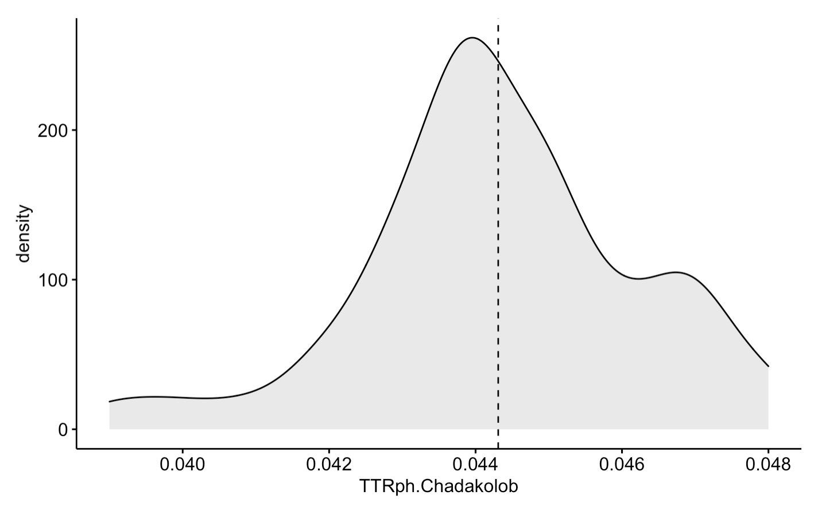
Sampling method
How many phonemes do we need to produce the text, e.g., of 1000 phonemes?
To answer this question, for each lect we take 50 samples of words with the total number of phonemes approximately equal to 1000 and calculate TTRph for each sample.
For example, this is the distribution of TTRph values in 50 samples for the Chadakolob variety of Avar.

Slide 48
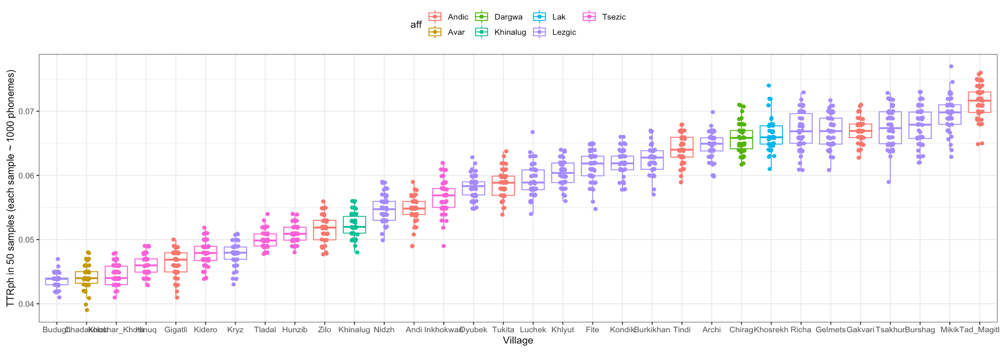
TTRph distribution in samples (all lects)
Notes:
Чтобы еще дальше раздвинуть, у меня ширины экрана ноутбука не хватает

Slide 49
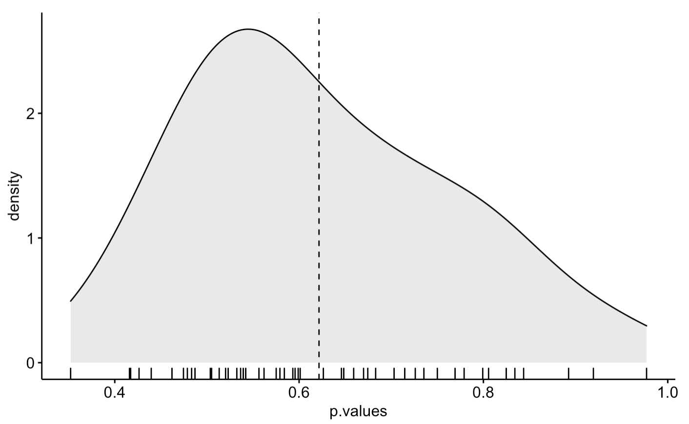
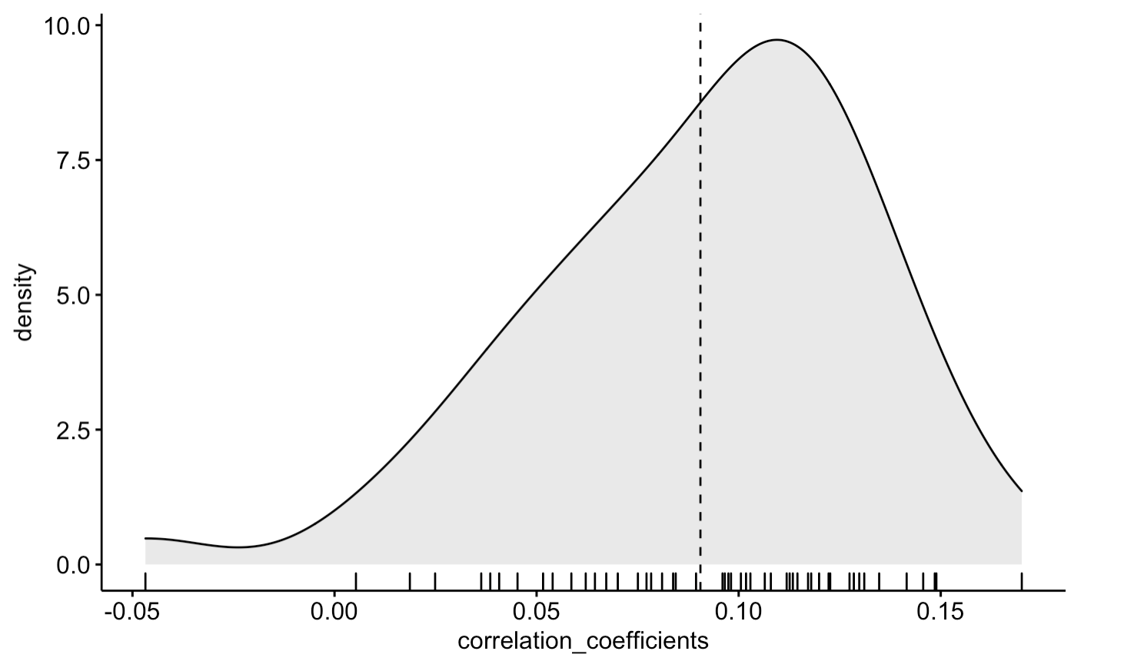
Correlation coefficients in individual samples
Finally, we checked the correlation between TTRph and altitude in each of the 50 samples.
Distribution of correlation coefficients
Distribution of p-values of correlation coefficients

Slide 50
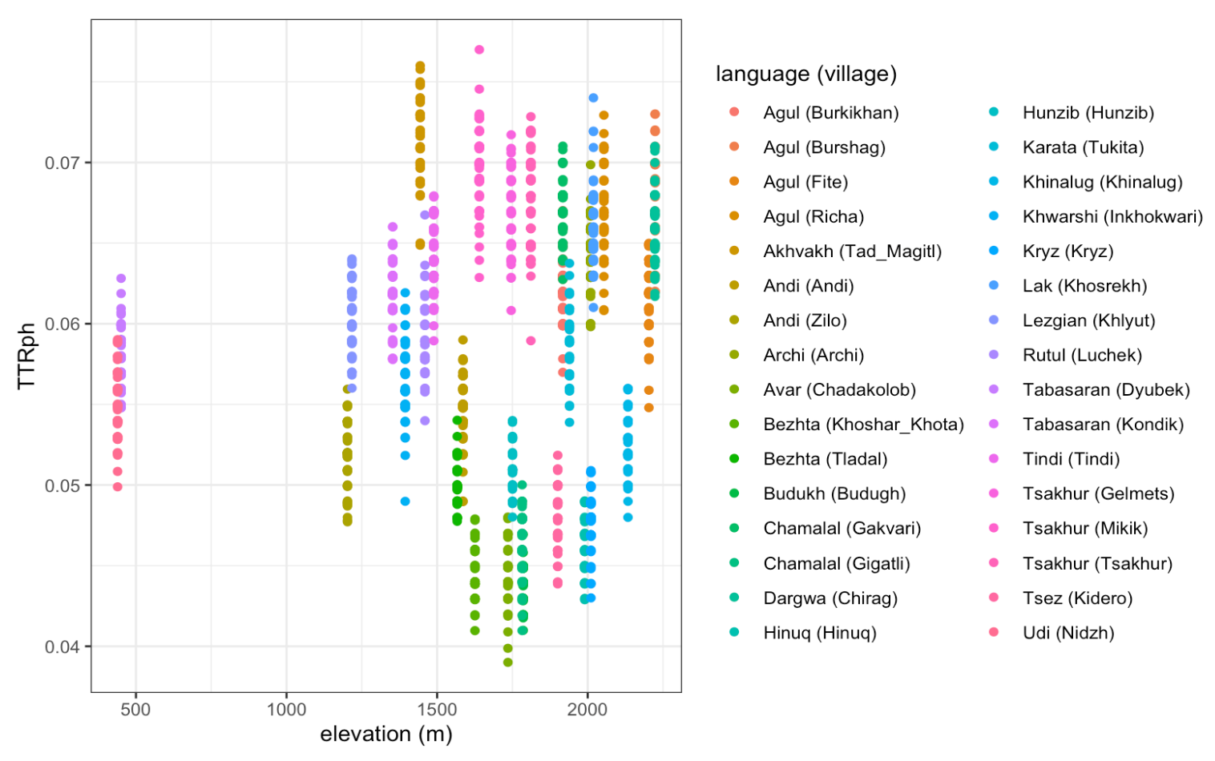
TTRph and altitude (all lects)
The results of cor.test() applied to the TTRph distribution vs. elevation:
cor = 0.09014599
p-value = 0.0003058
95 percent confidence interval = 0.04132273 0.13853978
To exclude possible genealogical signal, we also checked the correlation for individual branches (see next slides).

Slide 51
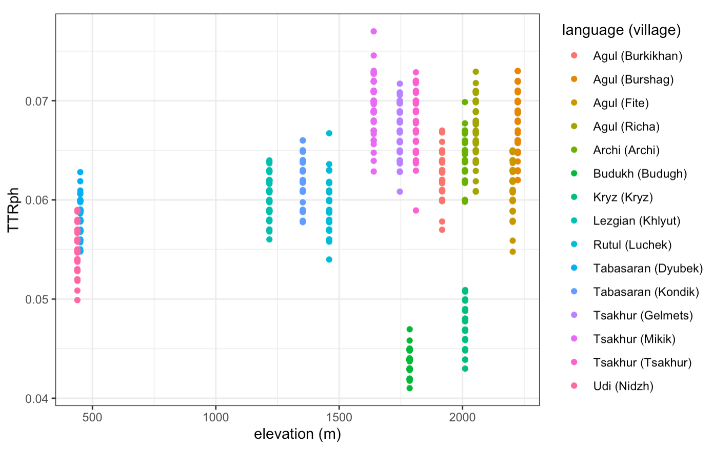
TTRph and altitude (Lezgic)
The results of cor.test() applied to the TTRph distribution vs. elevation:
cor = 0.2240164
p-value = 5.514e-10
95 percent confidence interval = 0.1549121 0.2909393
Note that Kryz and Buduch (outliers in the bottom) are influenced by Azerbaijani

Slide 52
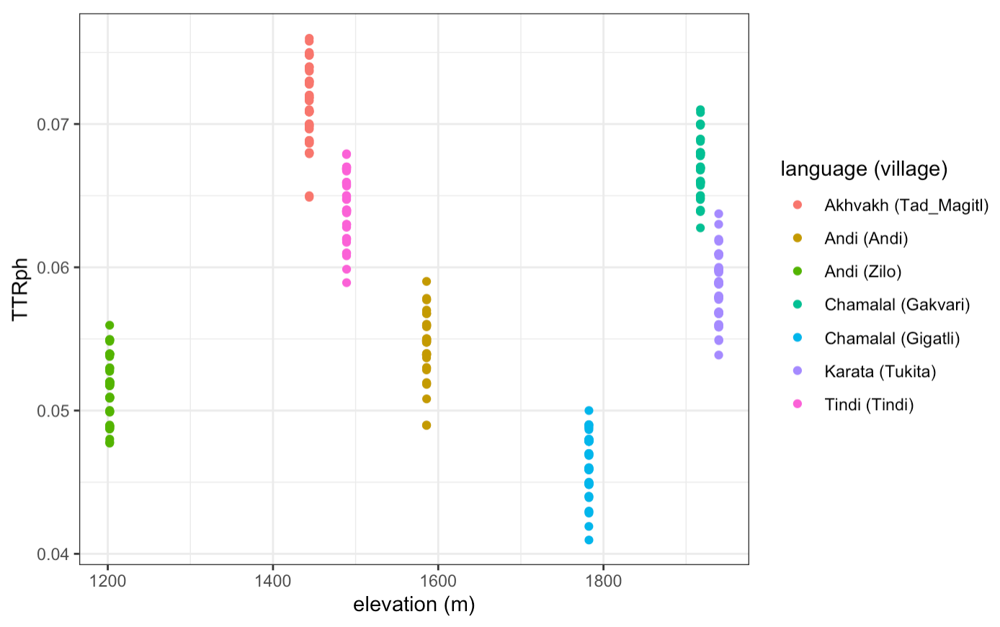
TTRph and altitude (Andic)
The results of cor.test() applied to the TTRph distribution vs. elevation:
cor = 0.03691314
p-value = 0.4912
95 percent confidence interval =
-0.06818052 0.14119659

Slide 53
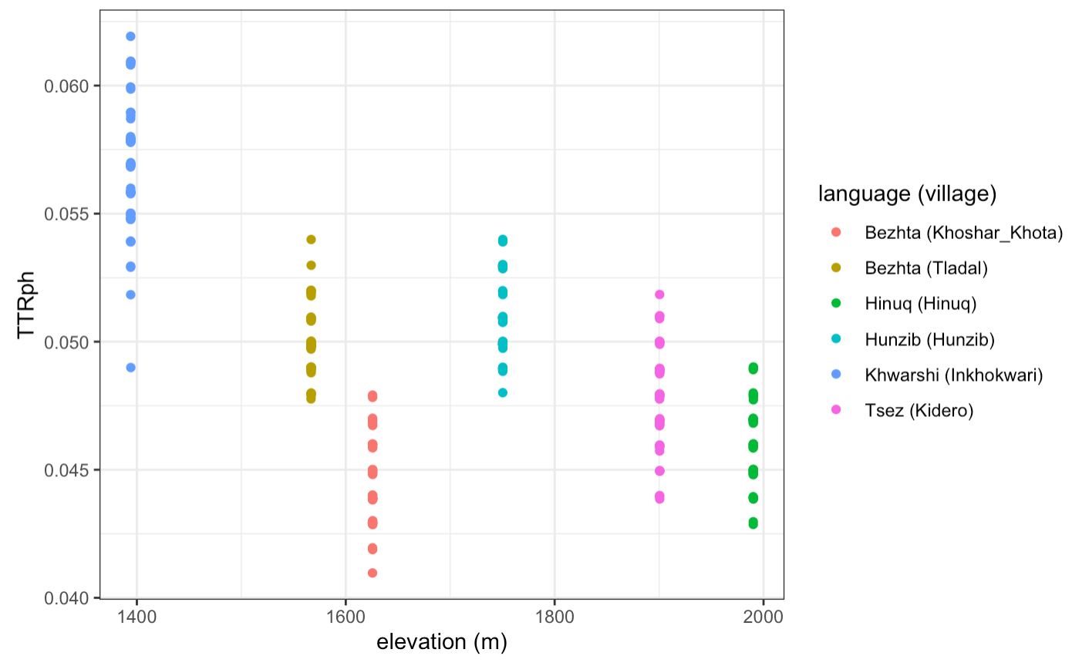
TTRph and altitude (Tsezic)
The results of cor.test() applied to the TTRph distribution vs. elevation:
cor = -0.6020456
p-value < 2.2e-16
95 percent confidence interval = -0.6696334
-0.5245677

Slide 54

TTRs and altitude (all lects)
Results of cor.test():
cor = 0.03653769
p-value = 0.1441
95 percent confidence interval:
-0.01249049 0.08539061

Slide 55

TTRs and altitude (Lezgic)
Results of cor.test():
cor = 0.3077272
p-value < 2.2e-16
95 percent confidence interval: 0.2414579 0.3711398

Slide 56

TTRs and altitude (Andic)
Results of cor.test():
cor = 0.2634208
p-value = 5.76e-07
95 percent confidence interval:
0.1630947 0.3583549

Slide 57

TTRs and altitude (Tsezic)
Results of cor.test():
cor = -0.5037982
p-value < 2.2e-16
95 percent confidence interval:
-0.5837366 -0.4141869

Slide 58

TTRs distribution in samples (all lects)
For the analysis of syllables, we take 50 samples of words with the total number of syllables approximately equal to 500.

Slide 59


Correlation coefficients in individual samples
Distribution of correlation coefficients
Distribution of p-values of correlation coefficients

Slide 60

The Gospel of Luke: TTRw distributions in samples
For the analysis of wordforms, we take 100 samples of sentences with the total number of wordforms approximately equal to 1000.

Slide 61

The Gospel of Luke: TTRw and altitude (median)
Problem:
In contrast to the KiKo data, translations of the Gospel of Luke cannot be associated with particular villages. What altitude values should we choose in this case?
The graph on the right shows median altitude for each of the languages.

Slide 62

The Gospel of Luke: TTR and altitude (assigned)
Another solution is to assign the altitude of one of the villages where language A is spoken to each TTR value of language A
The village is selected with a probability equal to the proportion of the population living in this village to the total number of speakers of language A
The data on population size come from Census 2010 (https://multidagestan.com/census)
Notes:
Удинский на этом этапе пришлось убрать, потому что для него нет данных по населению

Slide 63

The Gospel of Luke: TTR and altitude (assigned)
Results of cor.test():
cor = 0.09444757
p-value = 0.004571
95 percent confidence interval:
0.02928025 0.15881540

Slide 64

The Gospel of Luke (only Lezgic): TTR and altitude (assigned)
Results of cor.test():
cor = -0.489154
p-value < 2.2e-16
95 percent confidence interval:
-0.5603309 -0.4108055

Slide 65

Folklore texts
Data from four volumes of the series “Pamyatniki folklora narodov Dagestana” [Folklore of the peoples of Dagestan], folklore texts from 12+ languages with translations to Russian.
However, the corpora of different languages are of very different size, and thus cannot be directly compared: TTR depends on corpus size (even with sampling procedure).

Slide 66

Folklore texts: extrapolation of curves
We modify the growth curves with the R package zipfR: it redraws the curves based on the frequency lists of the texts and extrapolates the curves further according to the finite Zipf-Mandelbrot model (Baroni, Evert 2014: 9).

Slide 67

Folklore texts: distributions of TTRw
After that we slice extrapolated curves in 100 random corpus sizes and get 100 TTRw values for each language.

Slide 68

Folklore texts: TTR and altitude (median)
Similarly to the Gospel of Luke, it is not obvious what altitude should represent the altitude of the language spoken in many villages.
This graph shows median altitude for each of the languages.

Slide 69

Folklore texts: TTR and altitude (assigned)
In this graph the altitude is assigned to TTRw values. The choice of the altitude is conditioned by the number of speakers living in the village at the given altitude.

Slide 70

Folklore texts: TTR and altitude (assigned)
Results of cor.test():
cor = -0.05983883
p-value = 0.04724
95 percent confidence interval:
-0.1185265269 -0.0007345199

